Slide 1
Integrating HARP with TAPIS Framework
Swathi Vallabhajosyula
SGX3 2023 Summer Internship Reports
August 03, 2023

Slide 2
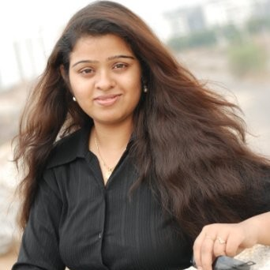
About Me
Manikya Swathi Vallabhajosyula
5th Year Ph.D. Student
Computer Science and Engineering
The Ohio State University
Advisor: Dr. Rajiv Ramnath
Professor of Practice,
The Ohio State University
Primary Research Interest:
Artificial Intelligence for Cyberinfrastructures (AI4CI)

Slide 3
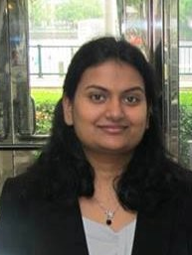
Team
Joe Stubbs
Anagha S. Jamthe
Nathan Freeman
Research Associate
Research Associate
Engineering Scientist Associate

Slide 4
Internship Goal
Understanding TAPIS Framework
Breaking Down of HARP to accommodate it into TAPIS
Learnings along the way (Container Images, API, DB)
In the next few slides:
A brief overview of HARP (Goal, Importance) [Summery of PEARC presentation – BEST paper]
Proposed Framework
Timeline
Trello Page: https://trello.com/b/9jwYK3kY/integrating-harp-with-tapis (Papers, Drafts and other relevant material)

Slide 5
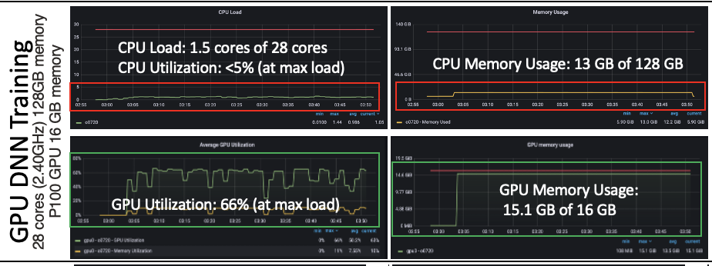
This or That?
How well do you know your allocation consumptions?
https://grafana.osc.edu/

Slide 6
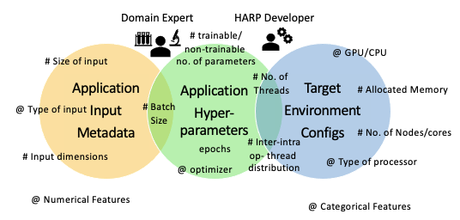
Problem Statement
Estimating the resource requirements for optimal resource utilization needs understanding:
Type of application (serial/parallel, compute or I/O-intensive)
The architecture and allocation policies of execution end-point (relationship between cores per node and memory allocations, GPUs per core, and GPU Memory)
Application Data and Hyperparameters (Loading Datasets into memory, type of optimizer)

Slide 7
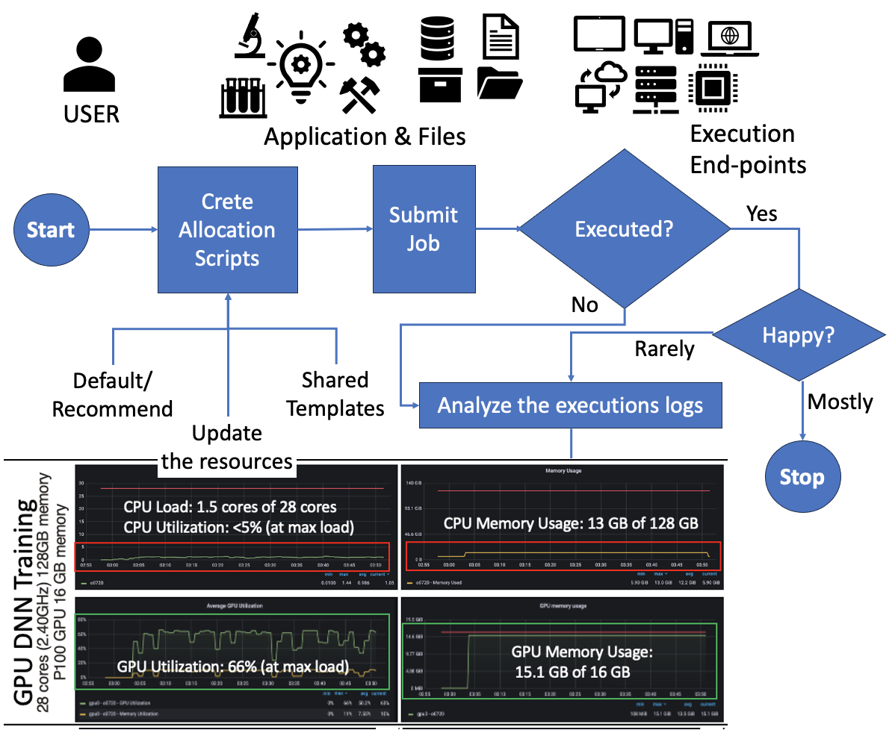
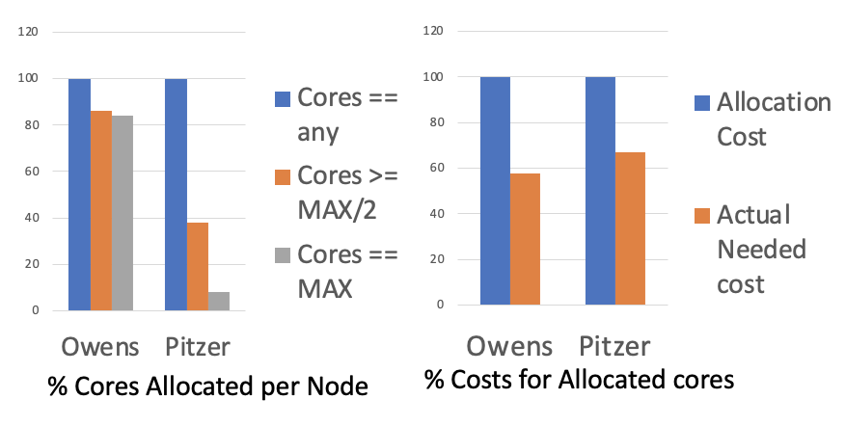
Manual Fine-Tuning Challenges
Image 2: User interaction with cyber infrastructures for resource allocations
How frequently do we fine-tune?
Changes in the third-party tools (upgrades)
Changes to the execution nodes
What motivates fine-tuning?
Cost of executions
Availability of cluster

Slide 8
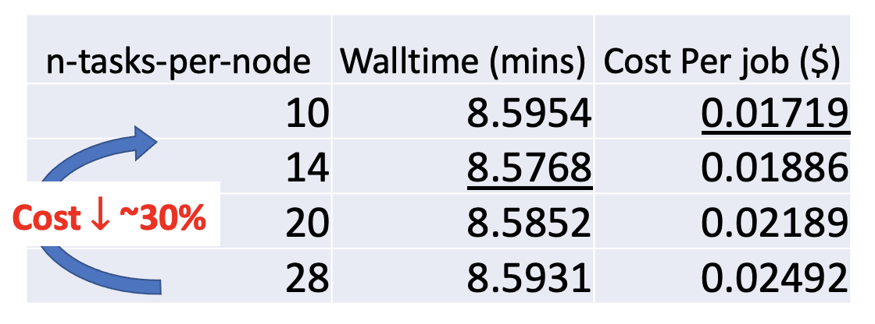
Goal
Can we build a framework to estimate the resource requirements (runtime) to execute an application on shared cyber infrastructures that could aid recommendation systems or smart job allocations for optimal resource utilization?

Slide 9
Challenges for building an AI-driven walltime estimator
Availability of execution history - training data
Understanding and capturing resource-specific features for machine learning
Choosing an appropriate regression model per target application
Selecting the appropriate execution configuration based on the CI allocation policies

Slide 10
HARP – HPC Application Resource (runtime) Predictor
The initial prototype presented in PEARC’22:
https://dl.acm.org/doi/abs/10.1145/3491418.3535172
The PEARC’23 Paper (Best Paper):
https://dl.acm.org/doi/abs/10.1145/3491418.3535172

Slide 11
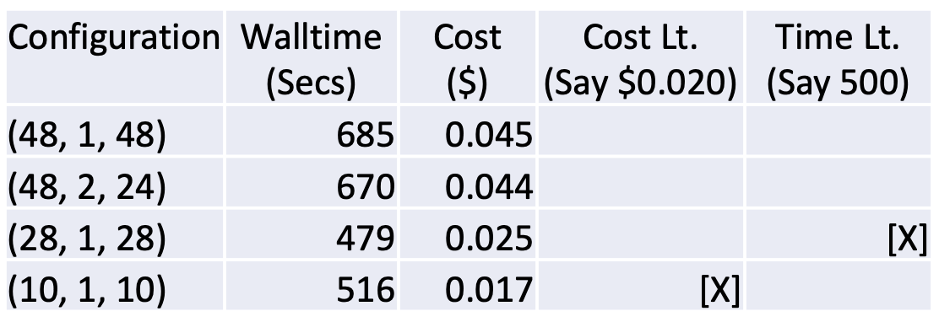
Execution Flow of HARP (version 1)
Single-user endpoint or standalone workflow
Start
Generate Data
Build Models
Start
Stop
Suggest Execution Configurations
Predictive
Models
End-point
policies
Stop
USER
Application, Files &
Profiling Configurations
HARP
Configurations
HARP Module – User end-point

Slide 12
Challenges – Integrating with TAPIS
Start
Generate Data
Build Models
Start
Stop
Suggest Execution Configurations
Predictive
Models
End-point
policies
Stop
USER
Application, Files &
Profiling Configurations
HARP
Configurations
How do we execute the “generate data” phase?
Giving control to end user?
Creating new task-queues to execute the jobs?
How can end users keep the session alive without controlling the generate phase?
How to we share models if users have control over the “generate phase”?
HARP Module – User end-point

Slide 13
HARP Server and Store
HARP with TAPIS – In progress
Application folder structure with CSV Files and models
HARP
Configurations
TAPIS User invokes this module
Runs as a container
Predictive Models
CSV Files
End-point
policies
Generate Data
HTTP API call
HARP Database
Save CSV to Server
Build Models
HTTP API call
Walltime - System
Application
Image
HTTP API call
Save The Models
Start
HARP Image
HTTP API call to fetch csv
Start
USER
Application
Suggest Execution Configuration
Build Models
Stop
HARP
Configurations
Lightweight Module- we could set a trigger or a schedule to build models in the server [future]. For now, this is a manually triggered endpoint.
Stop
Application, Files &
Profiling Configurations
Predict Walltime and System configurations

Slide 14
Timeline - Summary
Week 1
TAPIS Workshop
Creating a HuggingFace Application with TAPIS
Week 4
Tutorials
Week 7
Week 9
Had a wonderful week at PEARC23
Broke down HARP into containers and Services
Prepping the first release as API and Containers for ICICLE (Aug 21)
Learning: Mongo DB
Cratering services for CRUD – DB HARP modules
Prepping for PEARC23 (paper, Poster, Quiz)
Intro FLASK, Containers
Draft HARP integrations
Containerizing HARP
Submitted Demo for Science Gateways
Beyond
Will be releasing the TAPIS integration for next ICICLE releases (Continual Integration)
Submitting Poster/Panel for ScienceGateways and WHPC
Reward system for HARP

Slide 15
Magic Moments
Complete Software Development – after 7 years
Got to learn the latest technologies – Containers, MongoDB, Flask
Working with the available framework and restructuring code to make it more usable
Understanding TACC allocation policies
Encouraged to write papers (submitting a HARP-DEMO to Science Gateways)
Will continue working with TAPIS Integration – as part of ICICLE
Understanding the importance of Software Engineering (the reason why I chose Computer Science & Engineering 14 years ago)

Slide 16
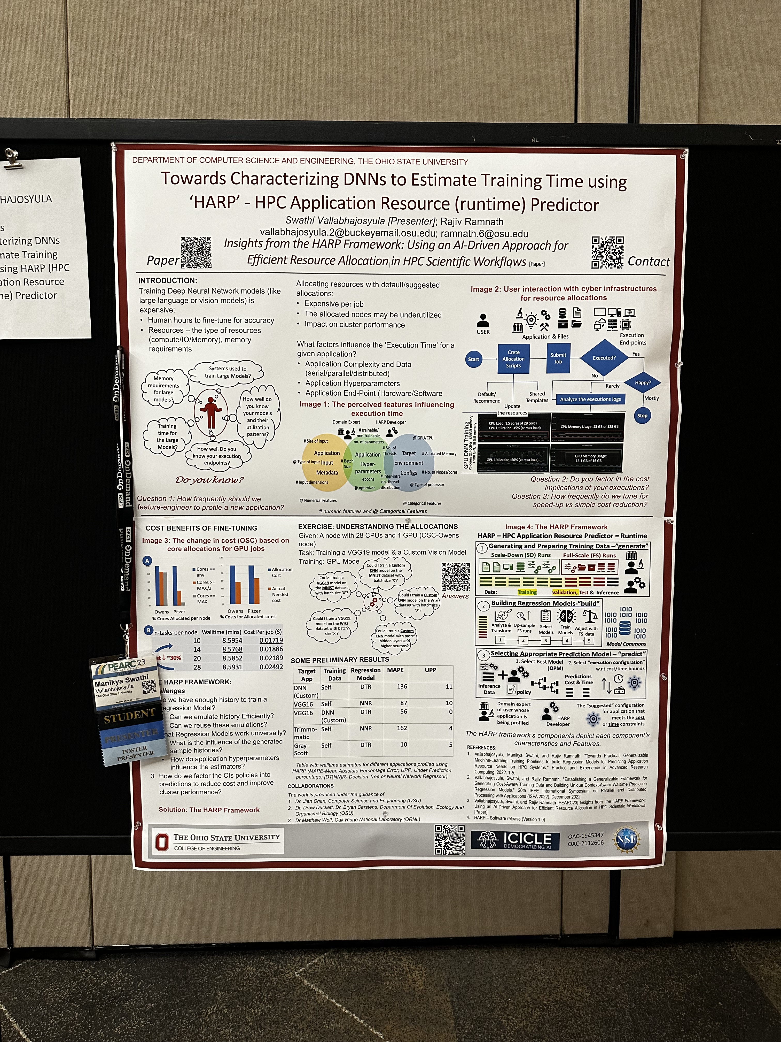
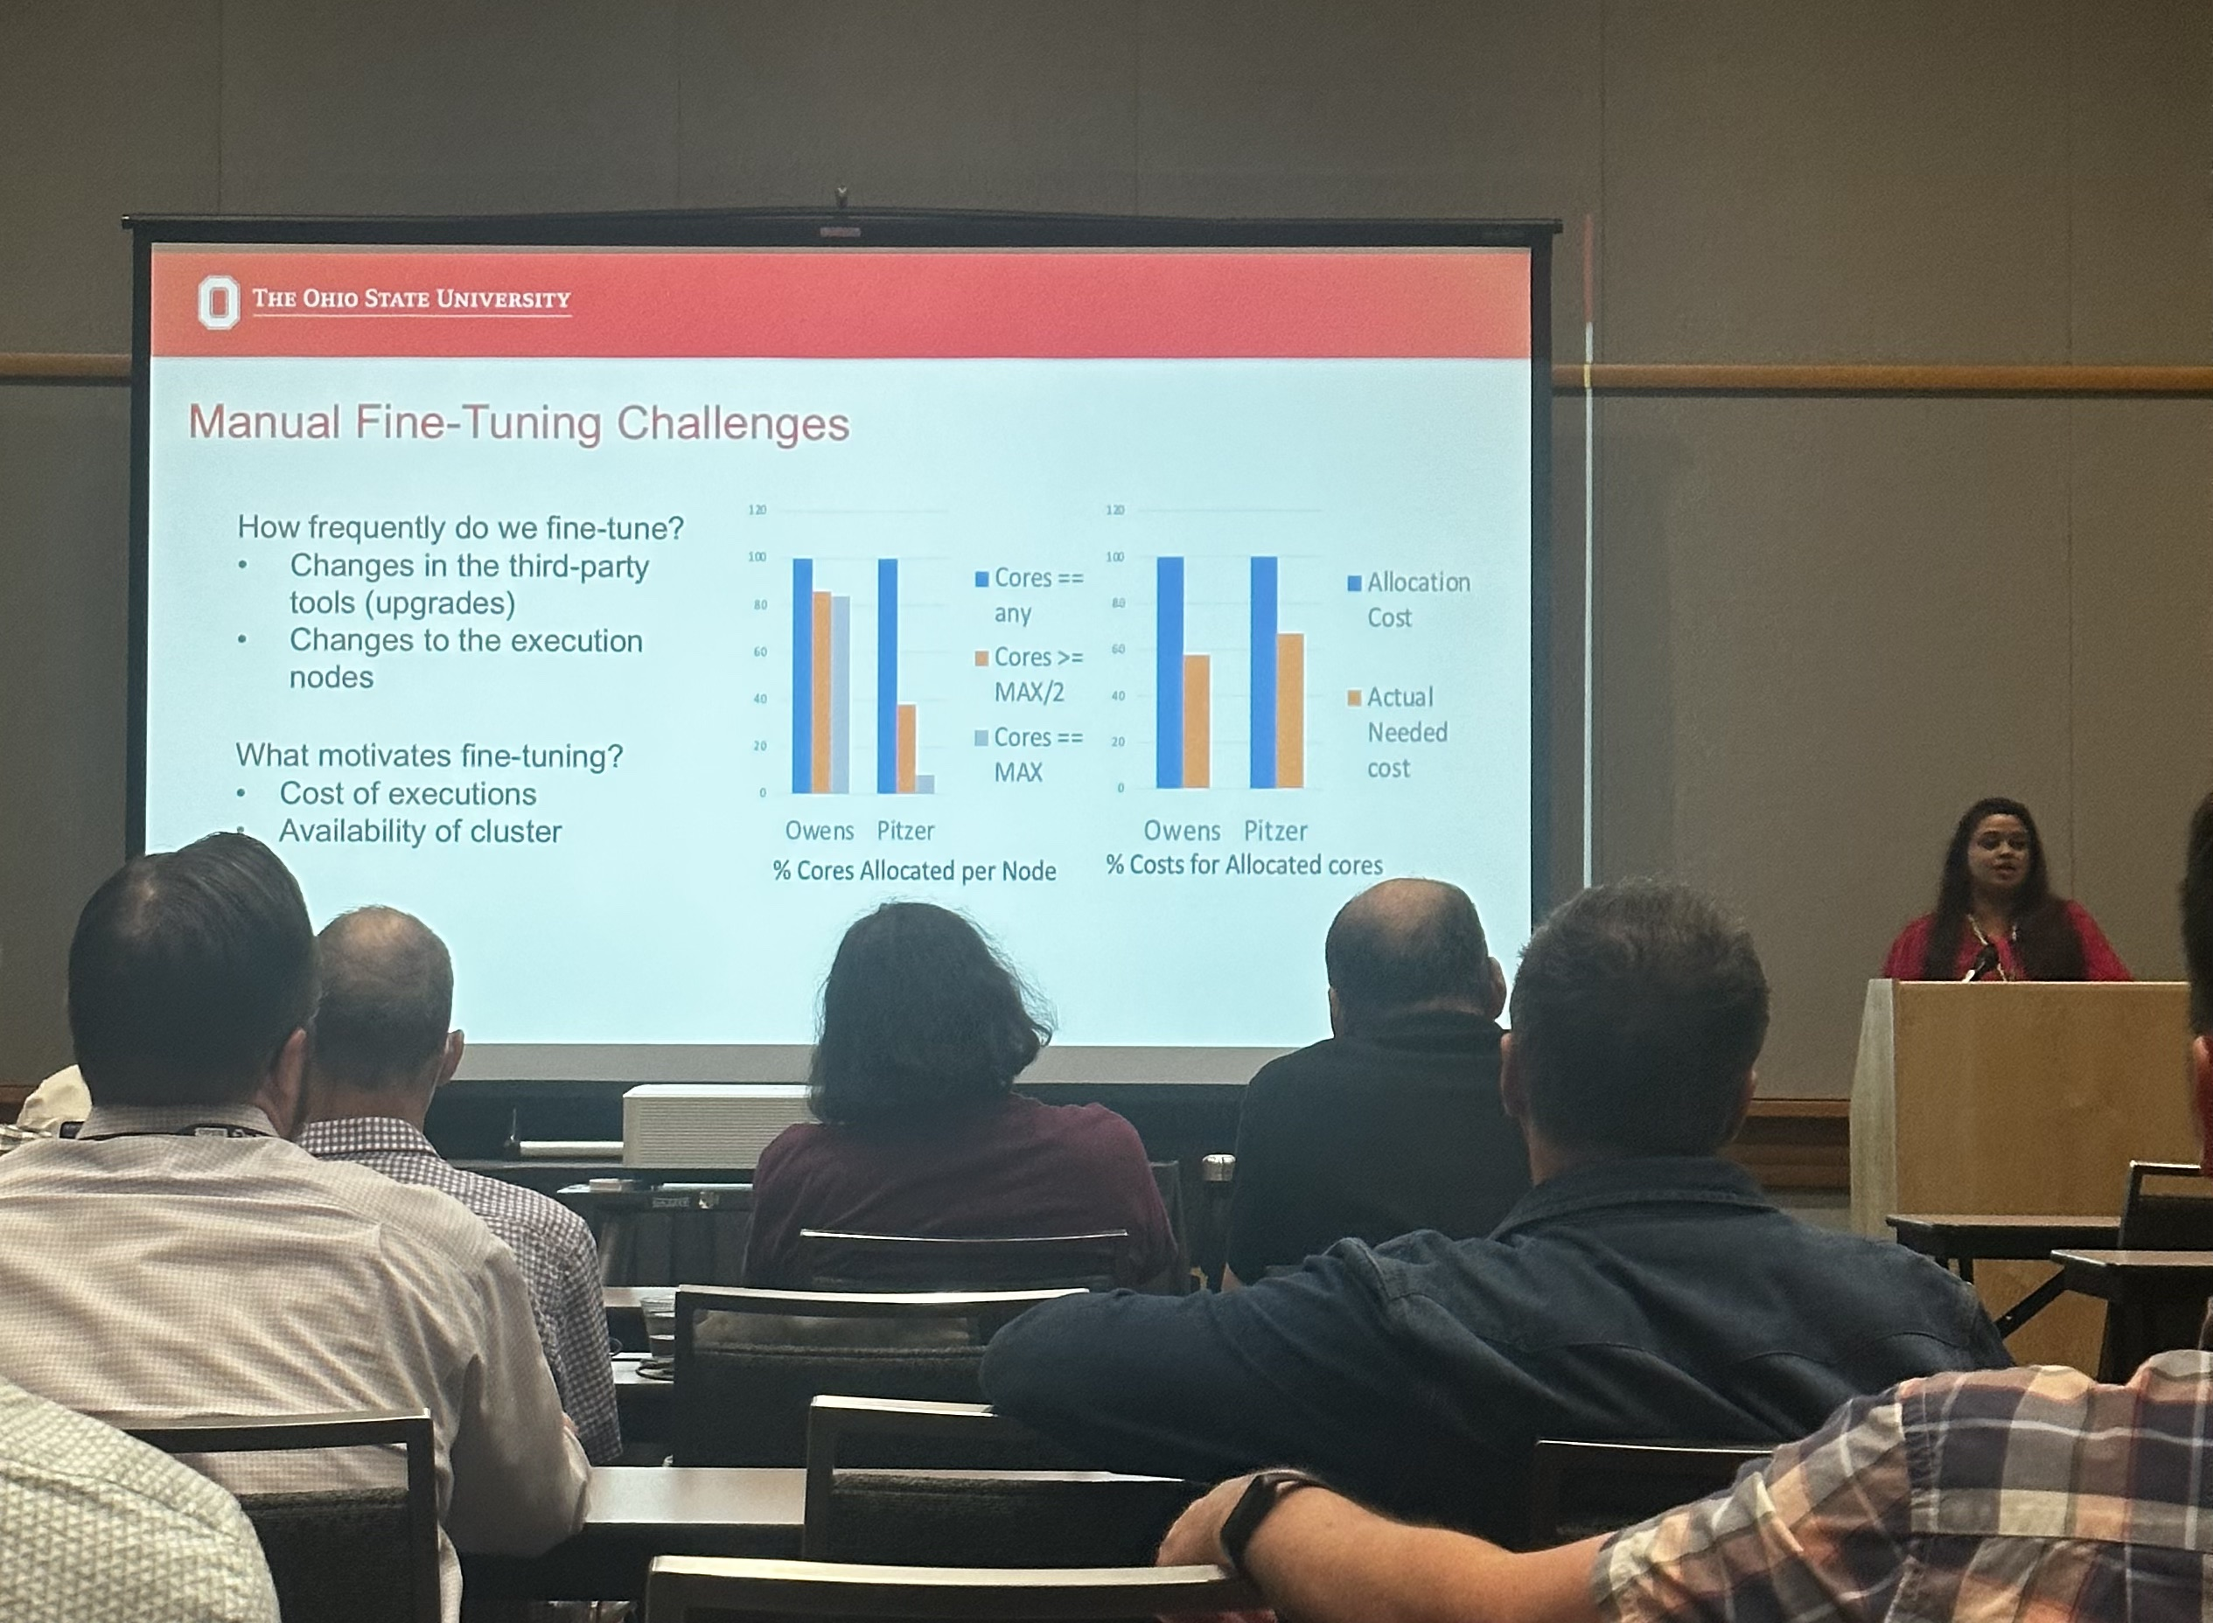
PEARC23

Slide 17
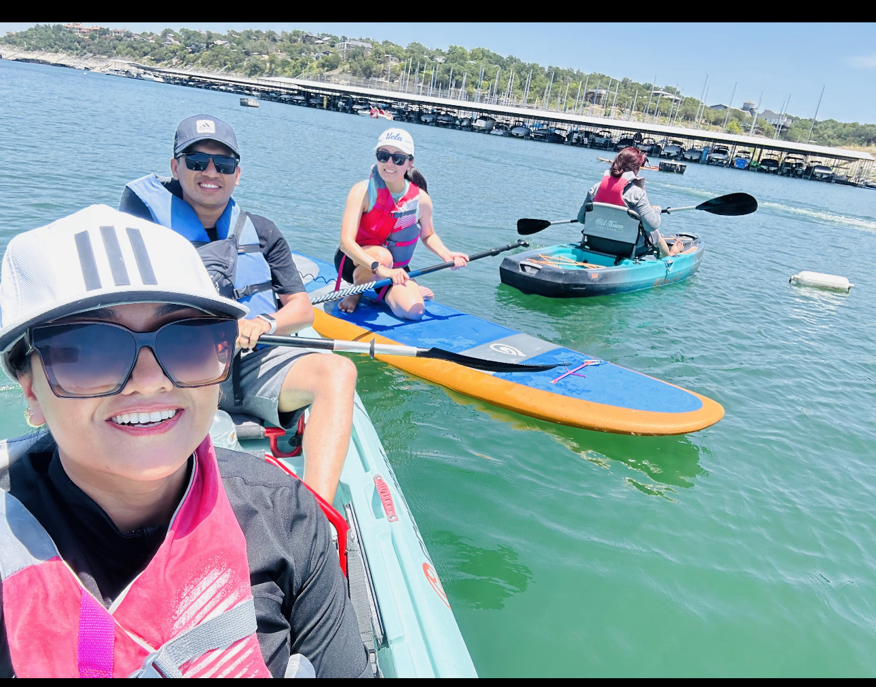
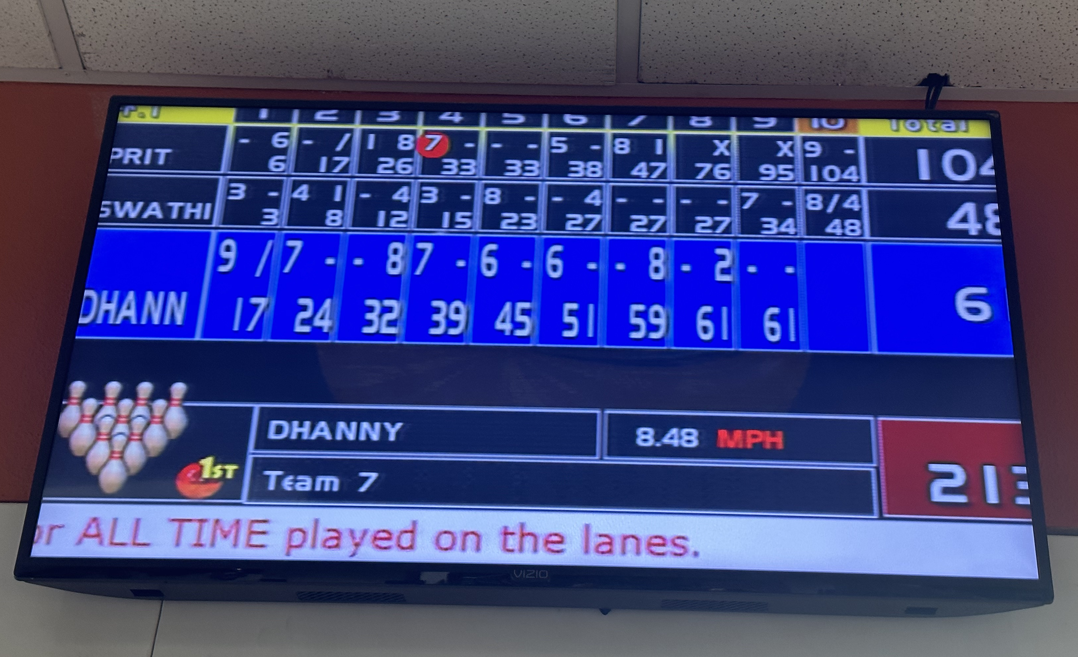
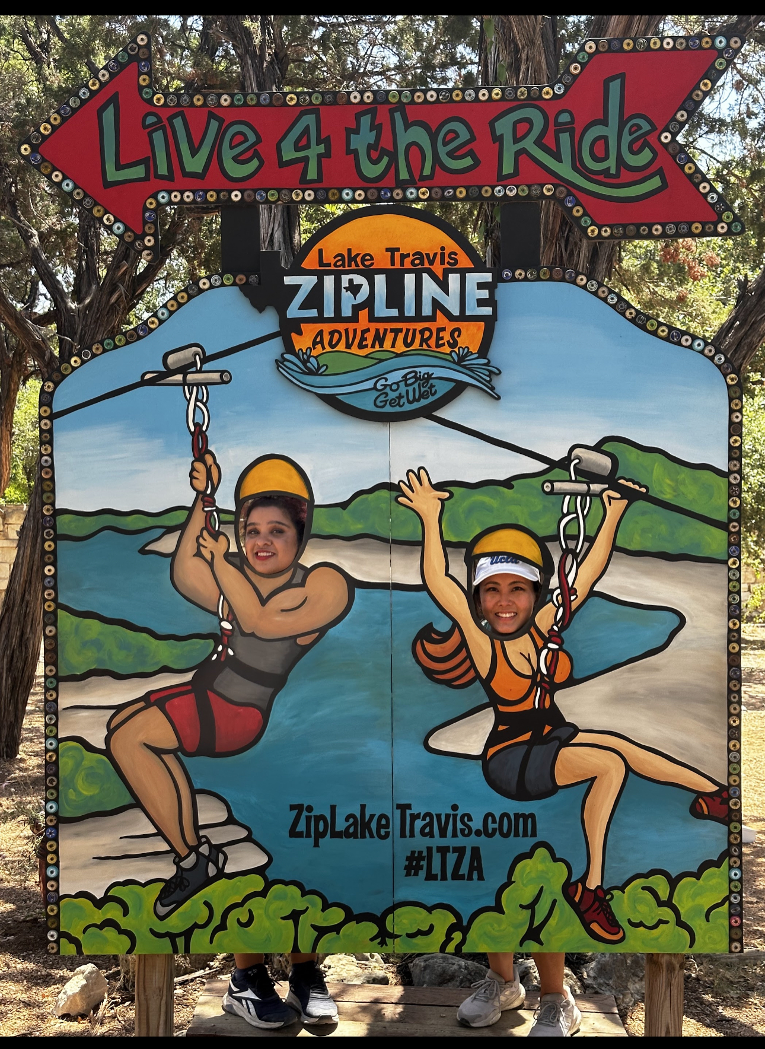
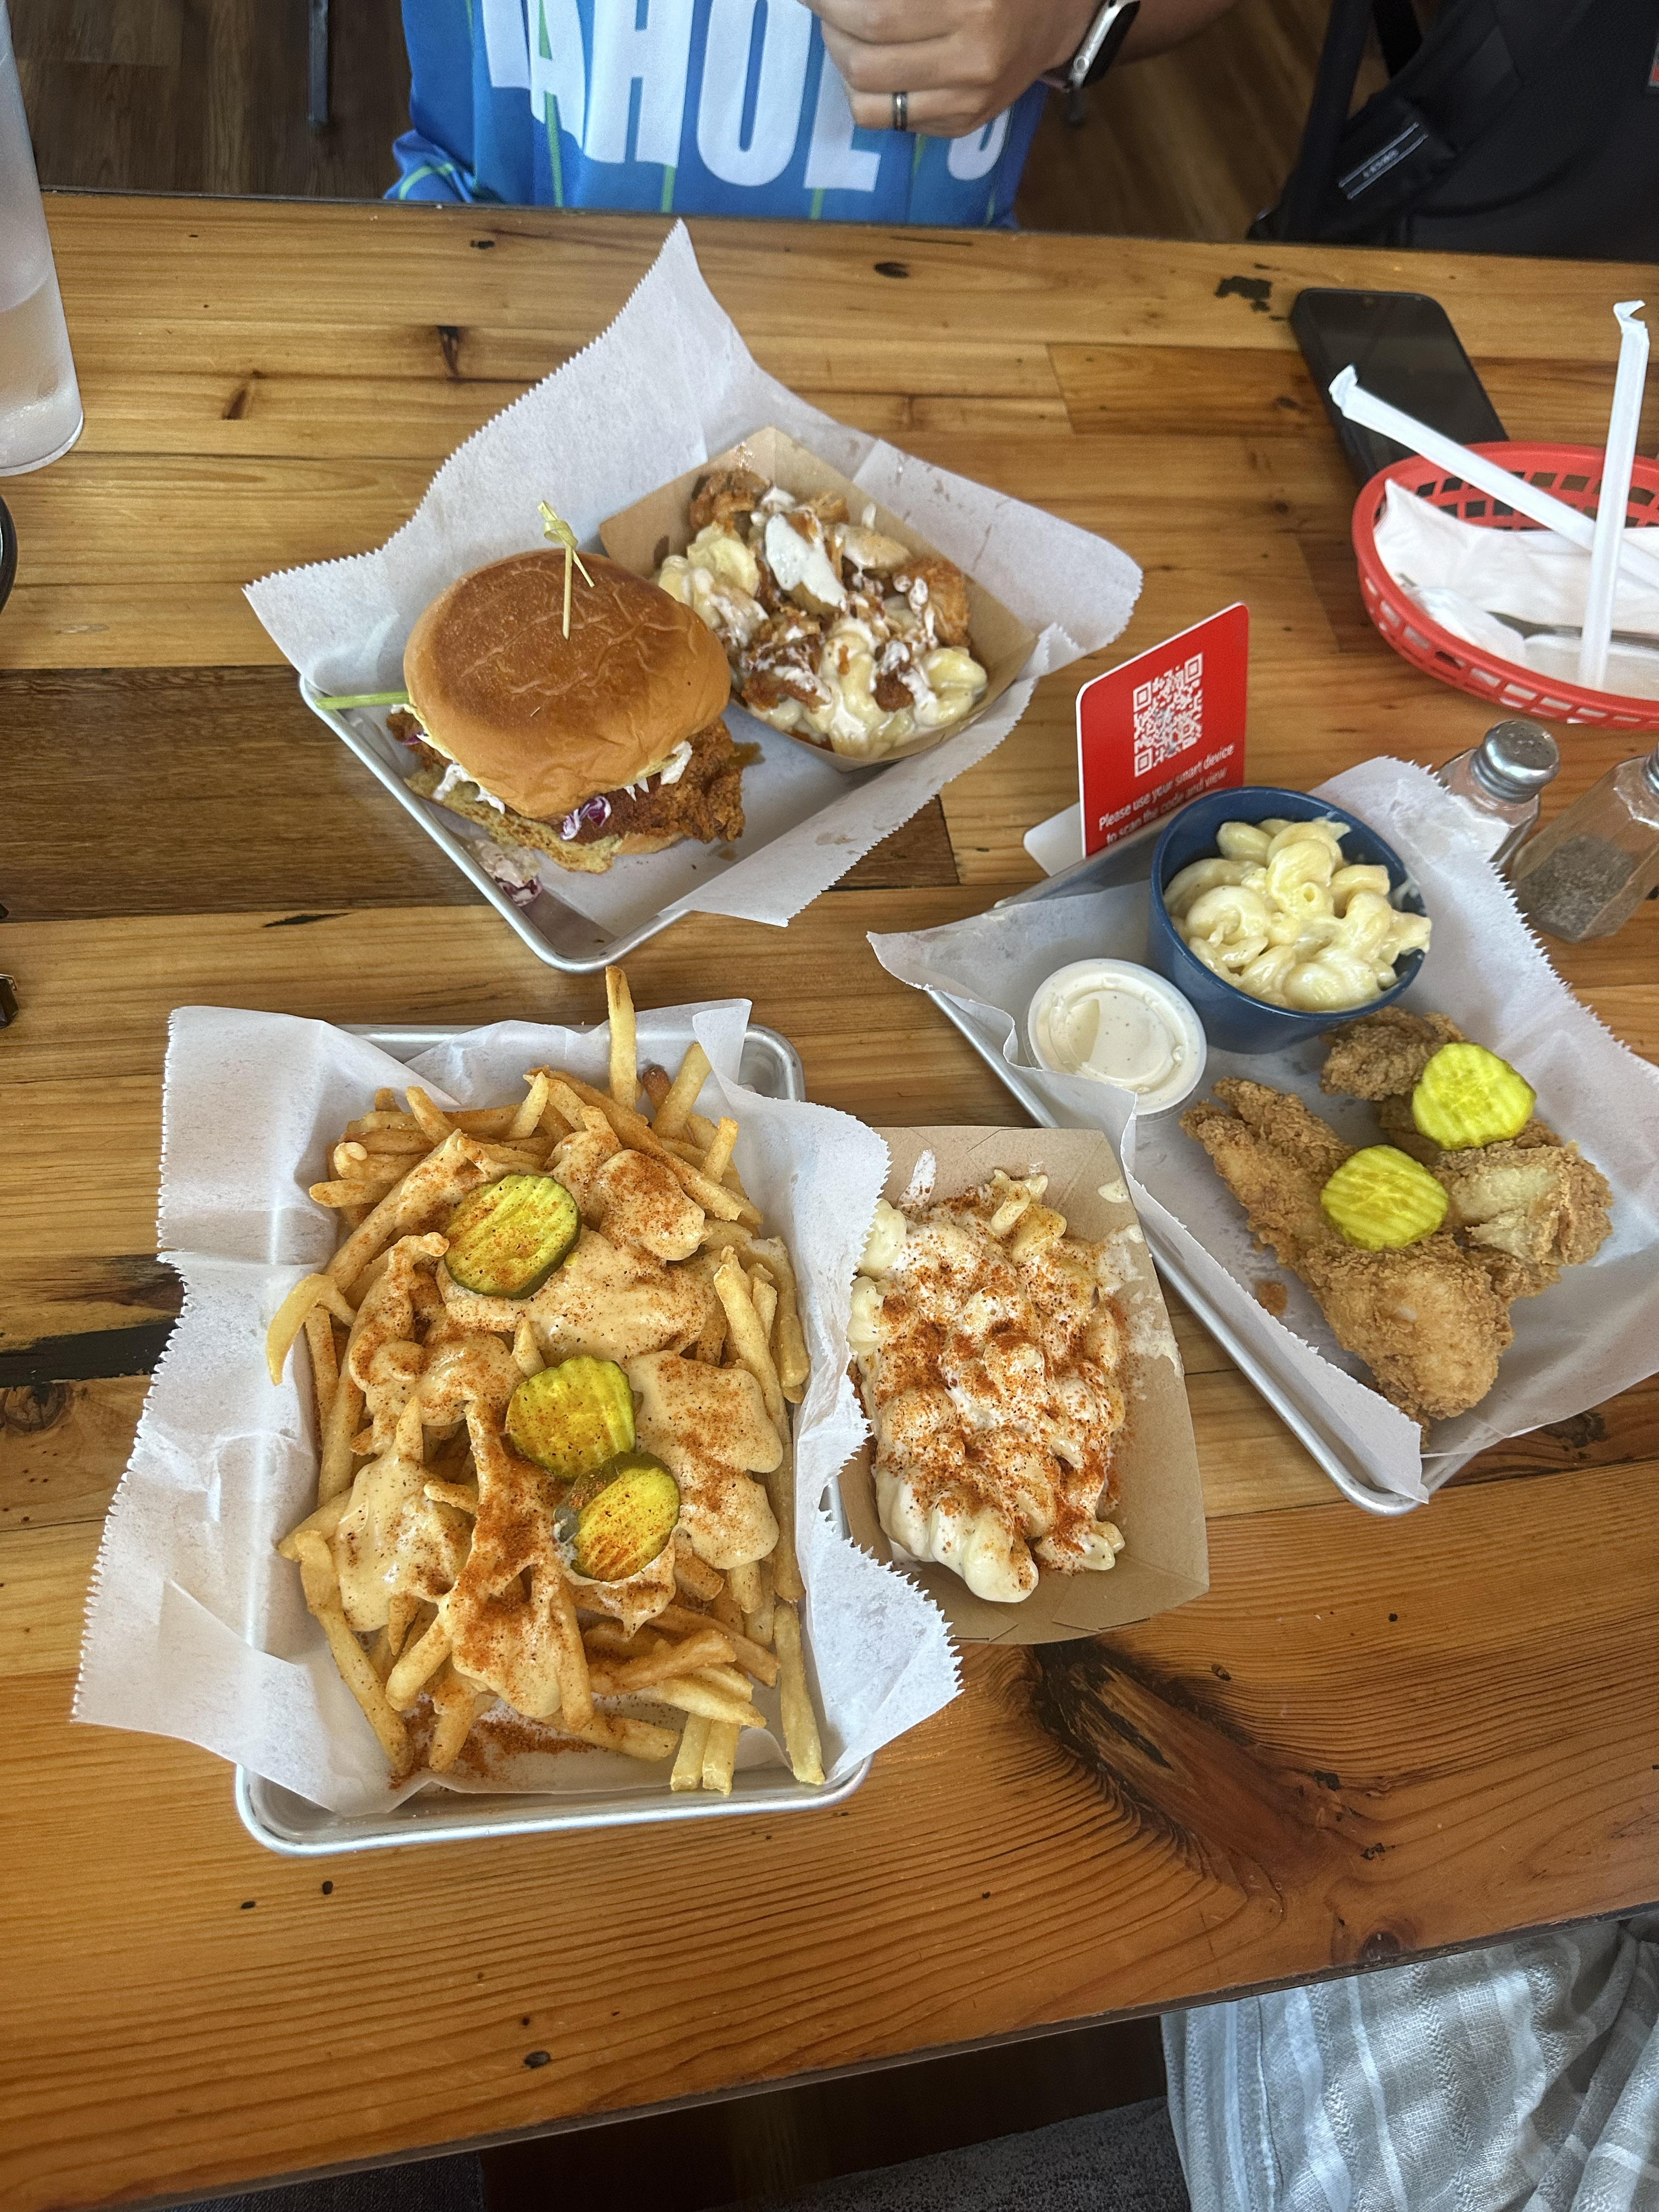
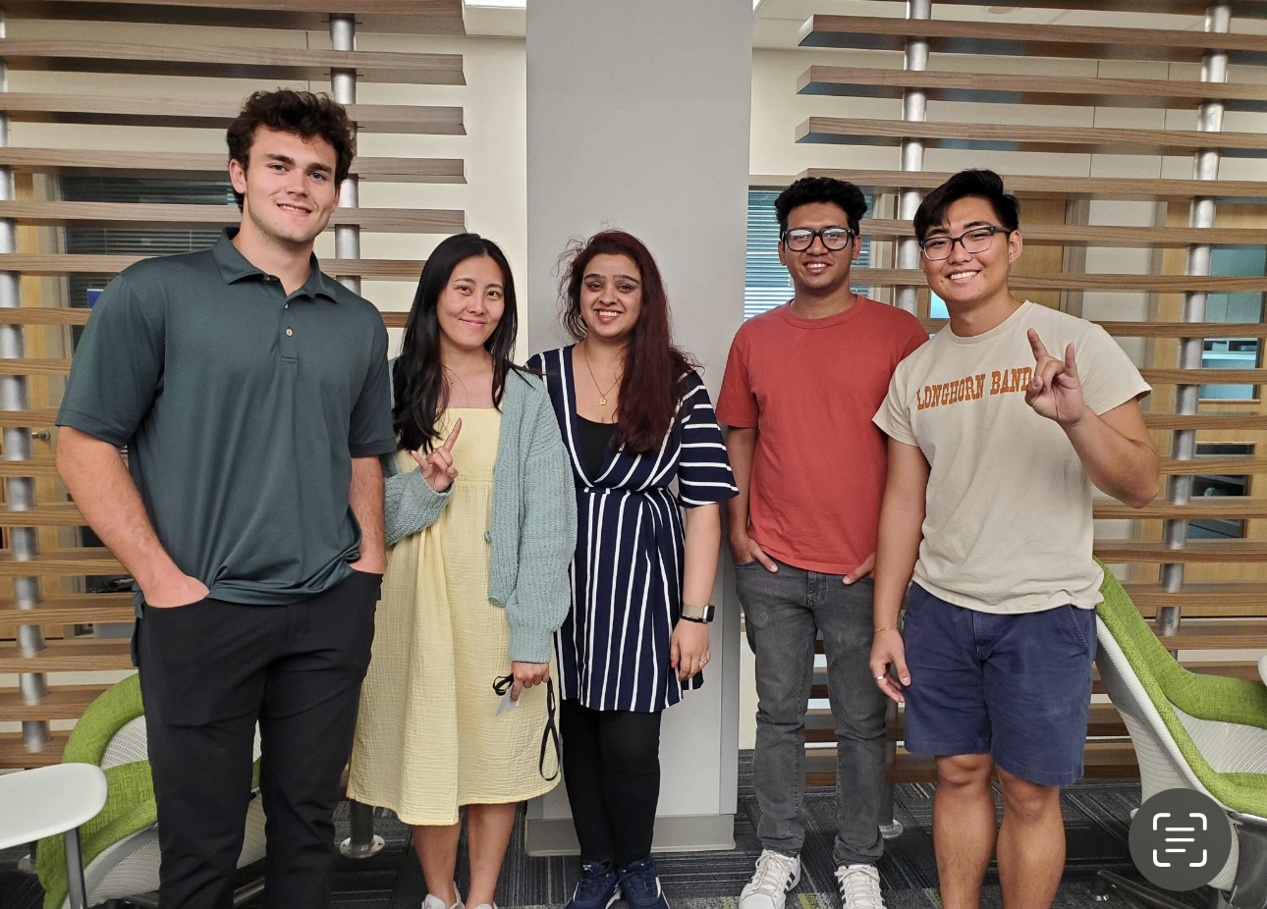
SGX3 times

Slide 18
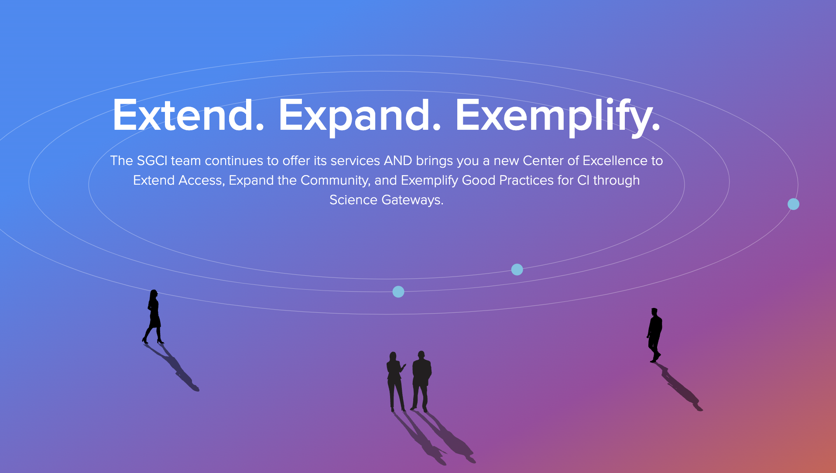
Thank You
Swathi Vallabhajosyula
vallabahajosyula.2@buckeyemail.osu.edu
swathi.Vallabhajosyula@gmail.com
https://manikyaswathi.github.io/
https://www.linkedin.com/in/manikyaswathivallabhajosyula/

