Slide 1
Gateways 2022 Conference Welcome
18 October 2022
Learn, Engage, Empower

Slide 2

Welcome back to our in-person series!
We’ve exceeded our expectations!

Slide 3
“I never knew there was a community of people like me…”

Slide 4
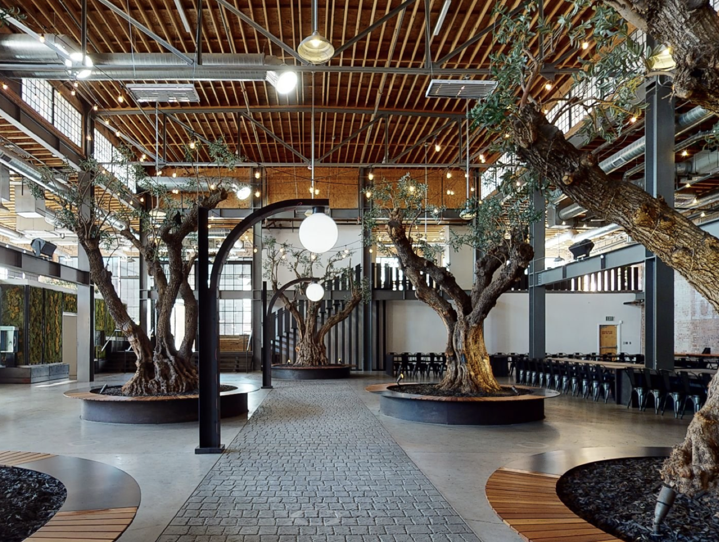
Be Inspired!
Network!
Help Define the Future of GATEWAYS!

Slide 5
Changes to our Format
A place to hear, not just a place to be heard
Learning with the right type of modality for the right type of content
Posters from high school through graduate research – your vote matters!

Slide 6
Method Behind the Keynote Series
Matthew Greenhouse
James Webb Telescope: an incredible source of data
John Towns
ACCESS:
a wealth of computing power to process data
Krishna Madhavan
Microsoft: using AI to translate data and computing into engaging educational experiences
Steven Ellis
NSF:
ways that NSF can support science gateways
Collect
Compute
Translate
Fund

Slide 7


Slide 8

?

Slide 9


Slide 10



Slide 11

Extend. Expand. Exemplify.
A Center of Excellence to Extend Access, Expand the Community, and Exemplify Good Practices for CI through Science Gateways.
Award #2231406

Slide 12
So SGCI got more funding then huh?

Slide 13
So SGCI got more funding then huh?
NO!

Slide 16
NO!

Slide 17
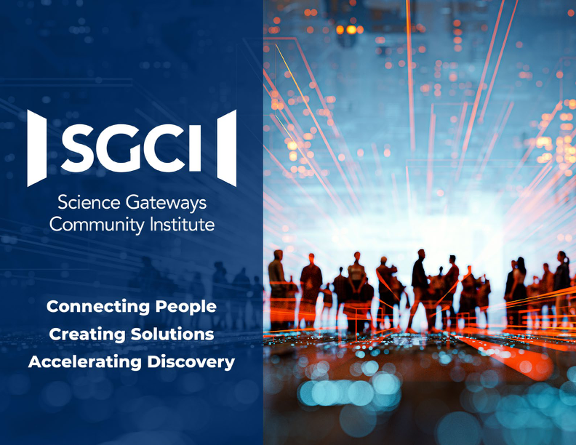
SGCI has facilitated some great impact stories and has shown an on average 7x acceleration in gateway development.
(if you don’t want to take the storybook with you please leave at the front desk)

Slide 18
A Center of Excellence and a Software Institute to serve the Science Gateways Community.
Helping…
Community Focused
Workforce Focused
Future Focused
Working Toward Preparing for the Future
Building…
Development Service Focused
Operations Service Focused
Heavy Touch Consulting
Working Toward Self-Sustainability

Slide 19
SGX3 – NSF Funded
SGCI – Client Funded
Community building activities
Workforce development activities
Light-touch consulting / advisory services
Envisioning the future through Blueprint Factories
  ACCESS
  PATh
  Materials Genome Initiative
  Sustainability practices
  more to come…
Heavy-touch consulting / other services
Software team augmentation / outsourcing
Professional science gateway operations
SGX3 is $7.5 million over 5 years beginning September 2022

Slide 20
Science Gateways

Slide 21
Science Gateways

Slide 22

Science Gateways

Slide 23
Science Gateways

Slide 24
Science Gateways
Increase domain science participation by 20% each year at the Gateways conference
Overlapping “Science Day” with Gateways conference
Get domain relevant gateways deployed in classrooms
Meet scientists where they meet – “On the Road”
Form partnerships
  Gateways that should not necessarily be separate
  Asset creators looking for a home for their work

Slide 25

Science Gateways
End Users
Gateway Partners
Gateway Owners
Gateway Operators
Gateway Developers
Framework Developers

Slide 26
Enterprises rarely fail because of technology.
Science Gateways
Enterprises often fail due to lack of adoption.
Lack of adoption is too niche of an audience or not delivering a strong value.
End Users
Gateway Partners
Gateway Owners
Gateway Operators
Gateway Developers
Framework Developers

Slide 27

Enterprises rarely fail because of technology.
Science Gateways
Enterprises often fail due to lack of adoption.
Lack of adoption is too niche of an audience or not delivering a strong value.
End Users
Gateway Partners
Gateway Owners
Gateway Operators
Gateway Developers
Framework Developers

Slide 28
Fun
Creative
Students
Sharing
Welcome!
Safe
Inspired
Let’s Be…
Social
Respectful
Participative
Ambassadors
Teachers

