Slide 1
Starting with a Firm Foundation: Building a Sustainability Program for the Australian Research Data Commons
IWSG 2023
Tübingen, Germany
Claire Stirm, Kerry Levett, Nancy Maron, Sandra Gesing, Andrew Treloar, Siobhann McCafferty and Juliana Casavan 15.06.2023

Slide 2
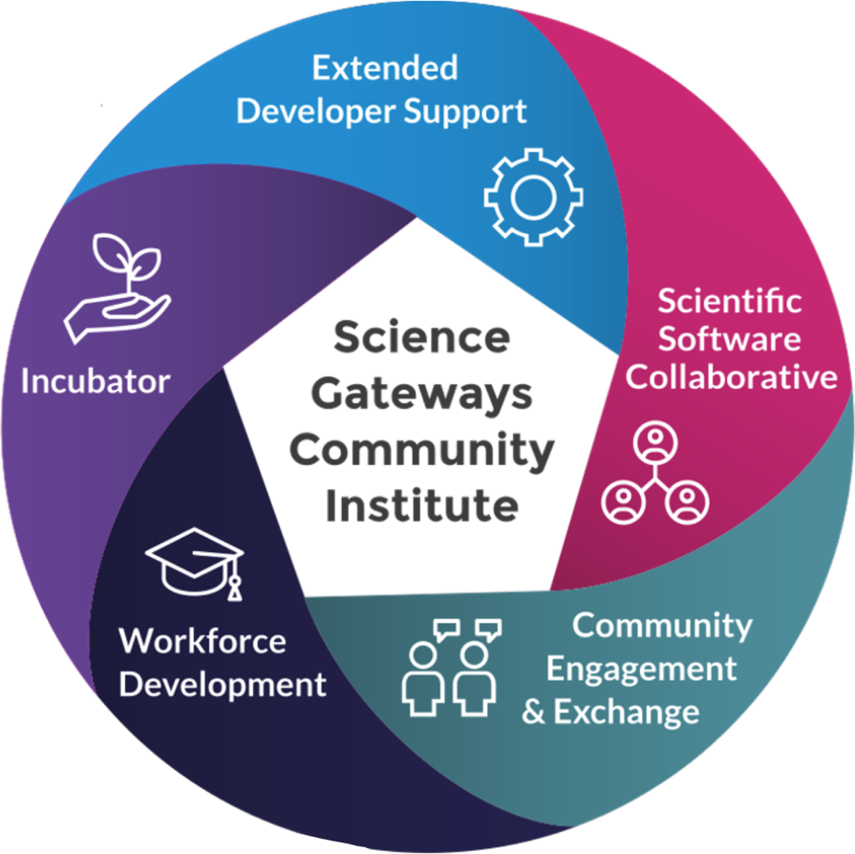
Sustainability for Science Gateways
Longer term support engagements
Software and visibility
for gateways
Diverse expertise
on demand
Information exchange
in a community
environment
Student opportunities and
more stable career paths

Slide 3
SGX3

Slide 4
SGX3 and SGCI
SGX3 funded
UX evaluation and design engagements lasting up to 3 calendar months
Technology evaluation and gap analysis
Science Gateway architecture design
Summer faculty and student internships
Once annually Science Gateways Focus Week sustainability sessions
Focus Week follow-on sustainability coaching
Summer Coding Institutes
Science Gateway Hackathons
Young Professionals program
Client funded
UX evaluation and design engagements beyond 3 calendar months
Technology selection, expert science gateway software development, and expert science gateway hosting and operations
Academic year intern placement
Specially commissioned Focus Week sustainability sessions
In-depth sustainability assessment and plan development

Slide 5
Bootcamp aka Focus Week
Core business strategy skills
stakeholder and user needs
operations
finance
resource planning
marketing and project management.
Technology best practices, e.g. usability and user-centered design
Long-term sustainability strategies
Alternative funding models
case studies of successful gateway efforts
licensing choices and their impact

Slide 6
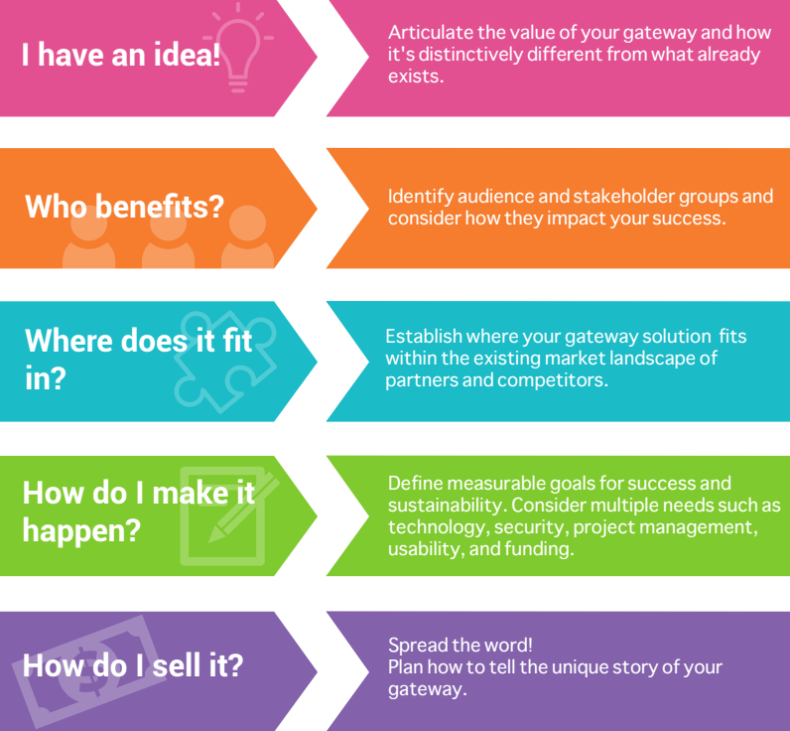
From Bootcamp to Focus Week
First one April 2017
5 full days
Teams on science gateways
Knowledge dissemination
Interactivity
Community formation
Putting away the normal daily routine
Homework

Slide 7
COURSE PLAN 2017
MONDAY
TUESDAY
WEDNESDAY
THURSDAY
FRIDAY
Your Audience(s) and Stakeholders
Mapping the landscape
Going beyond your initial market
Technology, Open Source
User Centered Design
Goal Setting
Budgeting
Cybersecurity
On-Campus Support
Funding
Models
Marketing & Outreach
Outreach
Your Sustainability Model – Making Your Case
Impact Measurement Case Study
Next Steps
Closing
Introductions
Course Outline and Goals
The “Napkin” Drawing
Defining Your Value Proposition

Slide 8
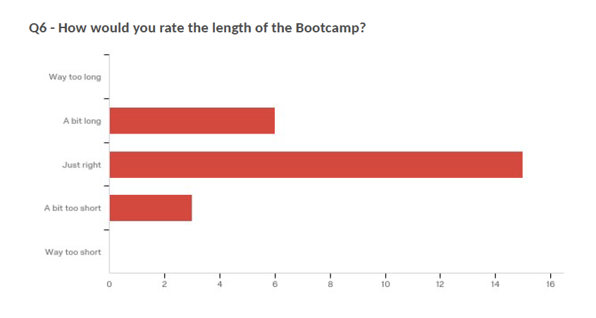
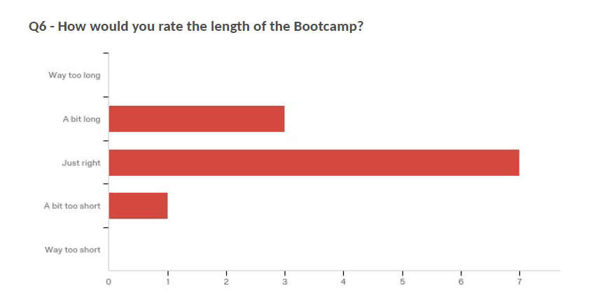
Feedback – Improvements
Bootcamp 1 Bootcamp 2

Slide 9
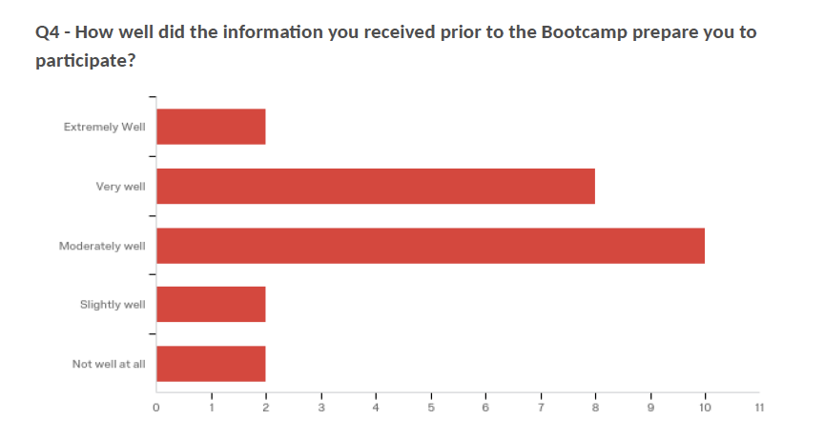
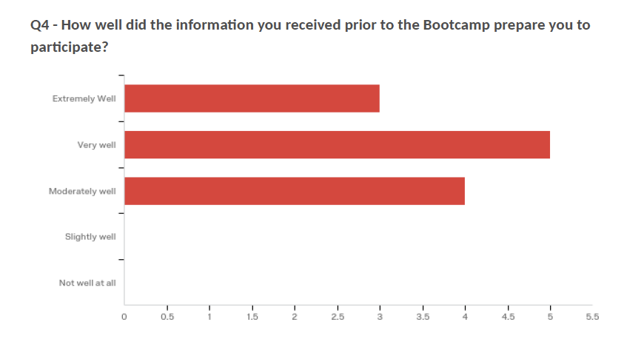
Feedback – Improvements
Bootcamp 1 Bootcamp 2

Slide 10
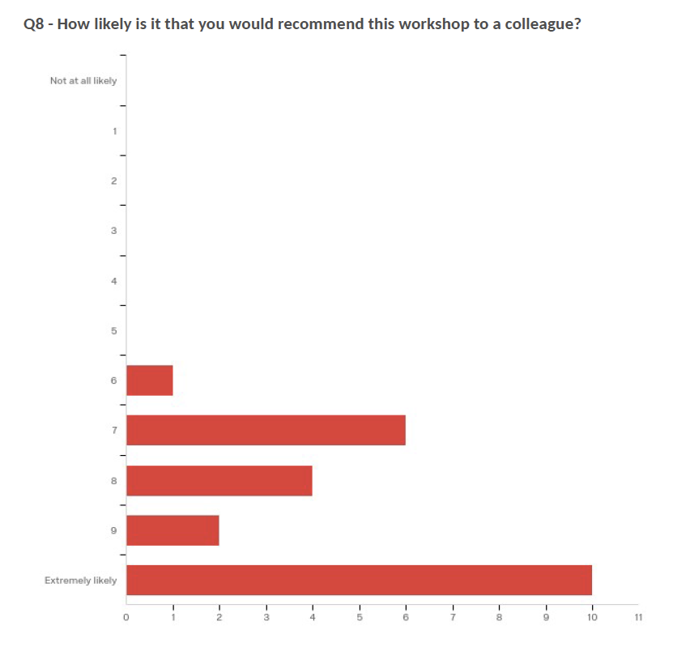
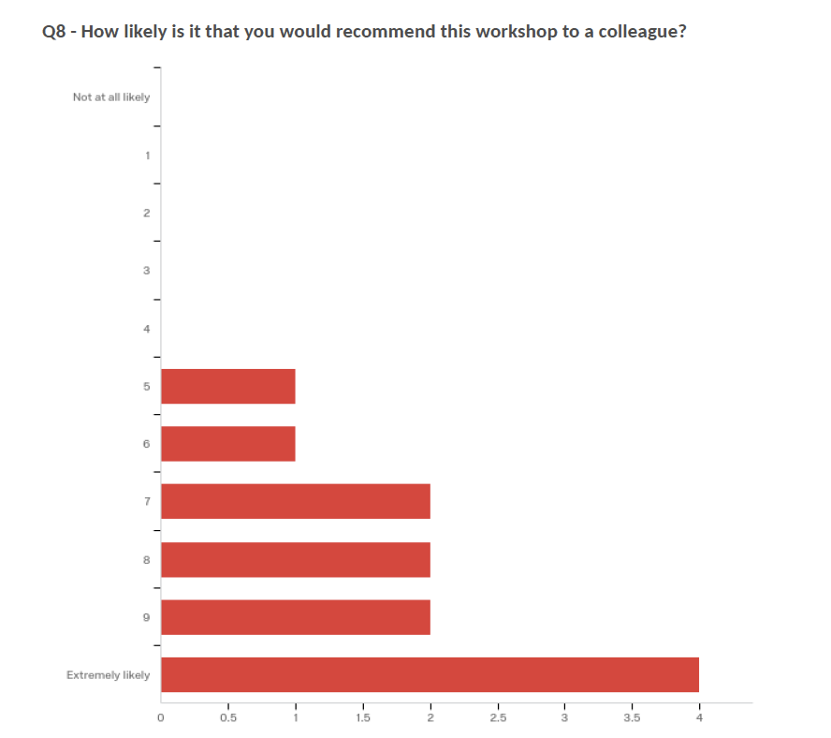
Feedback – Improvements
Bootcamp 1 Bootcamp 2

Slide 11
Feedback to the First Bootcamps
"The Science Gateways Bootcamp is useful to people involved at any stage of their science gateway project, and in any role. Their experts have you consider all aspects of sustainability, from understanding your unique value proposition and audience, through to best practices and standards in software development. They cultivate a lively, active, hands-on environment. A great experience overall.”
Steve Androulakis
Manager — Community Platforms, NeCTAR.org.au, ANDS.org.au, RDS.org.au (now at Amazon)
"The SGCI Bootcamp has fundamentally altered, in a constructive way, my view toward developing and implementing the projects on which I work. The work during the week helped me to generate a new approach to the gateway on which I'm working that has much greater potential to be successful, and I intend to apply the ideas and concepts from the Bootcamp to all project phases, from idea to implementation.”
Christopher Lenhardt
Domain Scientist for Environmental Data Science & Systems, RENCI Data Observatory
Risk Analytics Discovery Environment (RADE) gateway

Slide 12
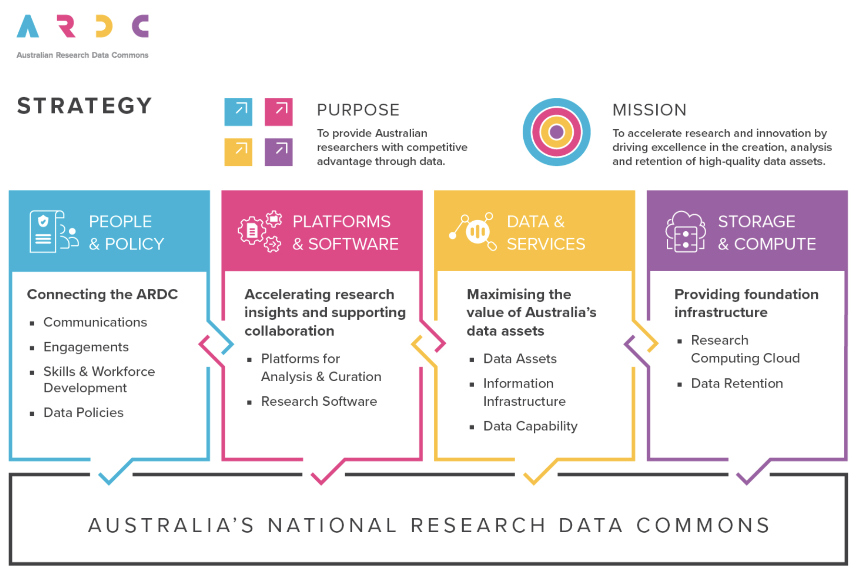
Australia’s leading research data infrastructure facility

Slide 13
25 research platforms aka science gateways

Slide 14
Focus Week Topics
Napkin Drawing
Understanding Your Audiences & Key Stakeholders
Environment-Mapping the Landscape
Marketing Tactics Tools
Goal Setting
Value Proposition
Budgeting
Market Development
User-Centered Design

Slide 15
Focus Week Restructuring
No session longer than 90 minutes
Online over 2 months (eveing in the US, morning in Australia)
SGCI instructors would present a core topic, in a virtual session, encouraging interactivity as much as possible.
Each day’s presentation was then immediately followed by an SGCI ARDC debriefing session, permitting the SGCI instructors to meet with ARDC program leads to review the material covered, and prepare for the work sessions to come
A formal “work session” for participants was then led by ARDC staff to provide feedback to project teams and answer questions

Slide 16
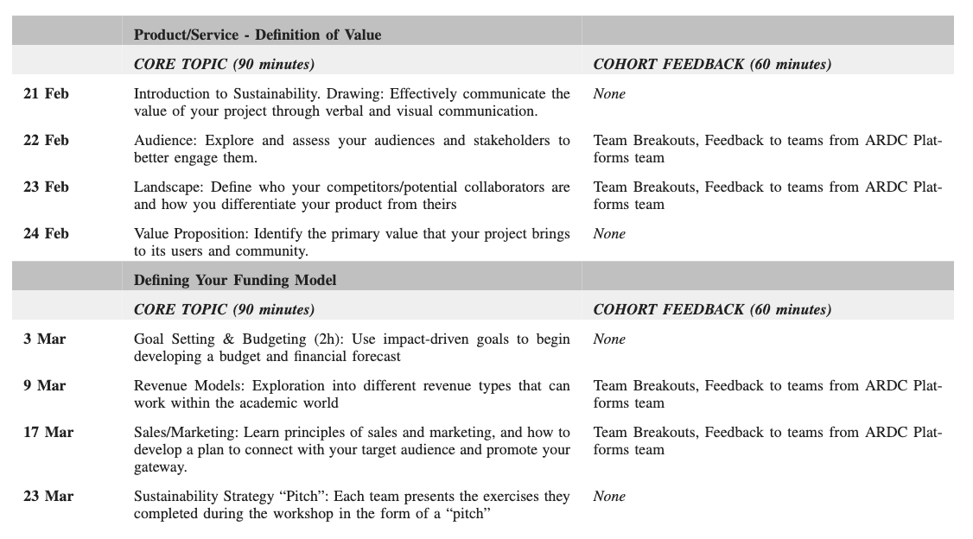
Focus Week Agenda

Slide 17
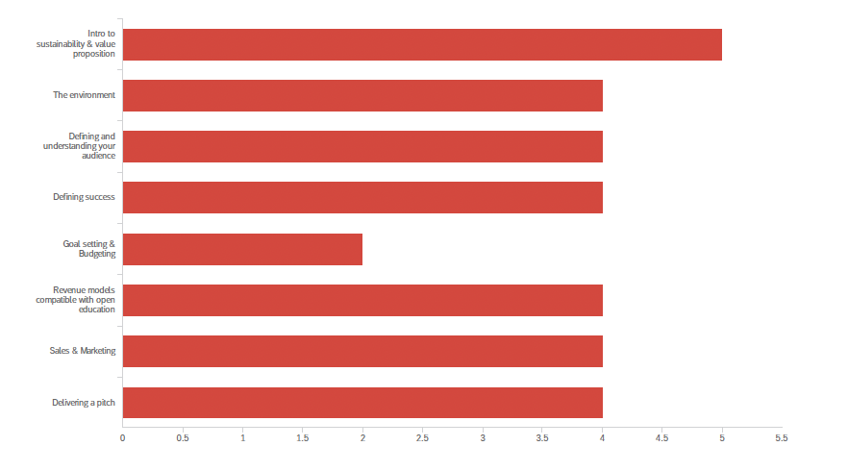
Focus Week
74 attendees
16 projects provided their pitch deck

Slide 18
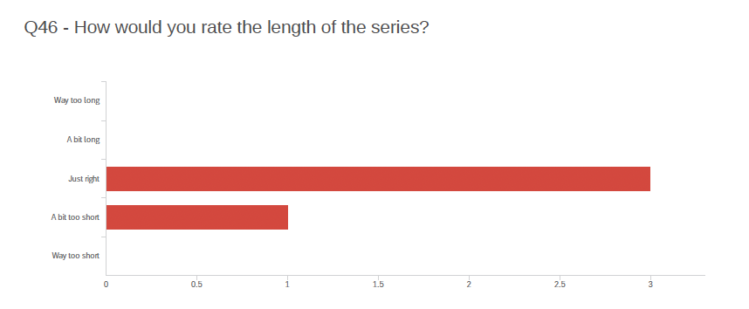
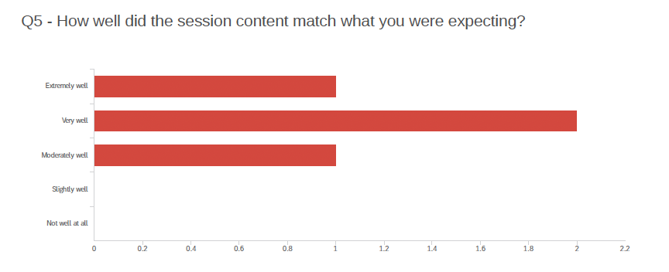
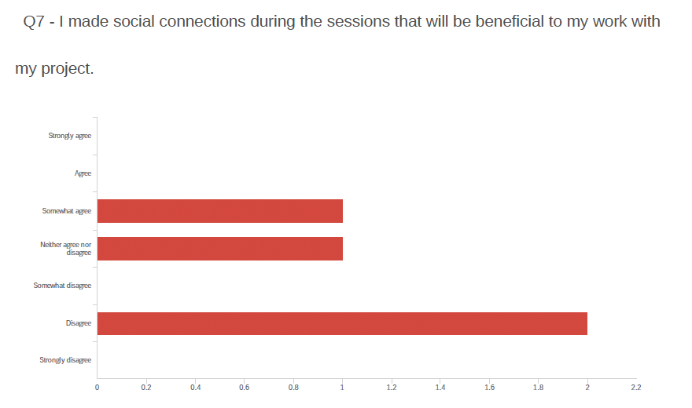
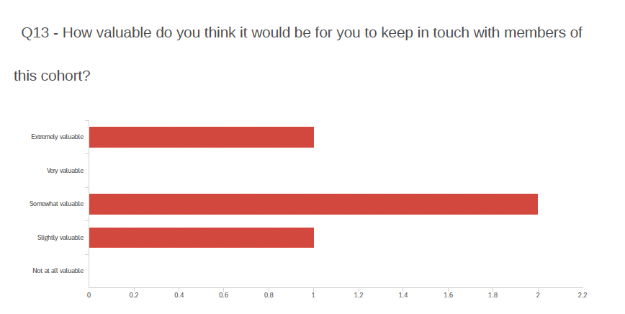
Feedback

Slide 19
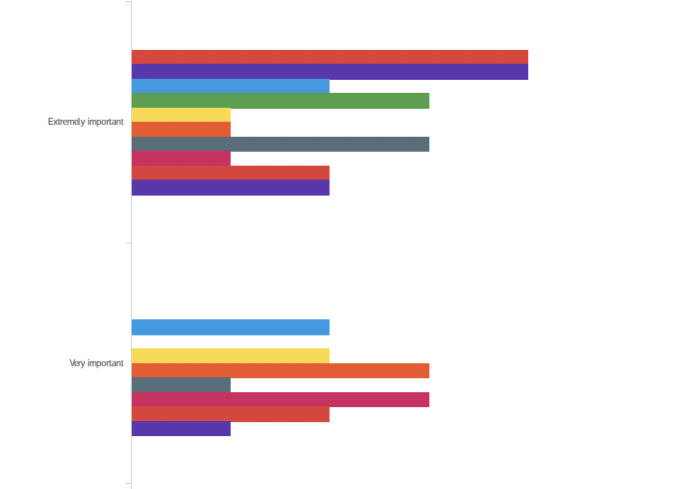
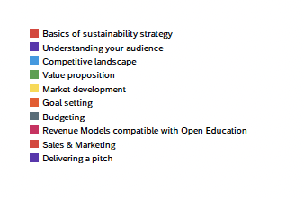
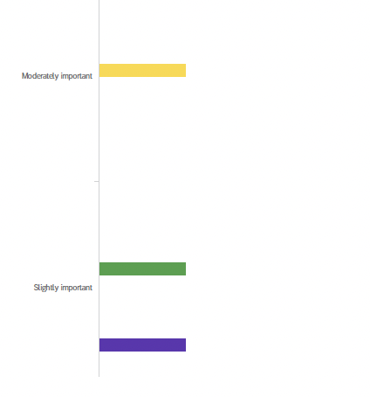
Feedback
How important do you think the
following components are to the
success of your project?

Slide 20
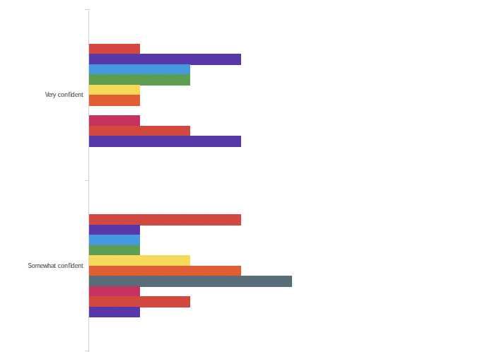
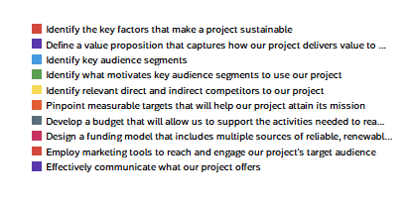
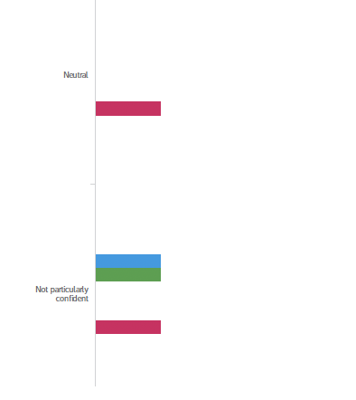
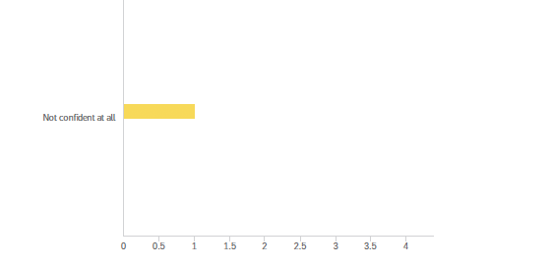
Feedback
How confident do you feel today concerning your ability to successfully conduct the following activities?

Slide 21
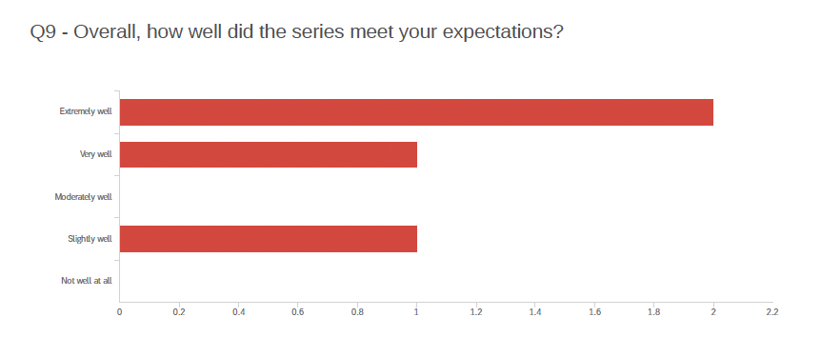
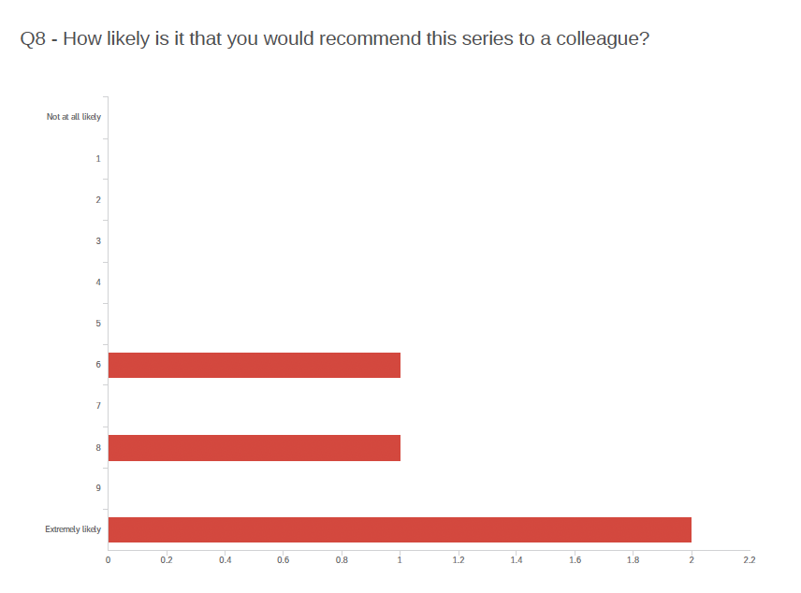
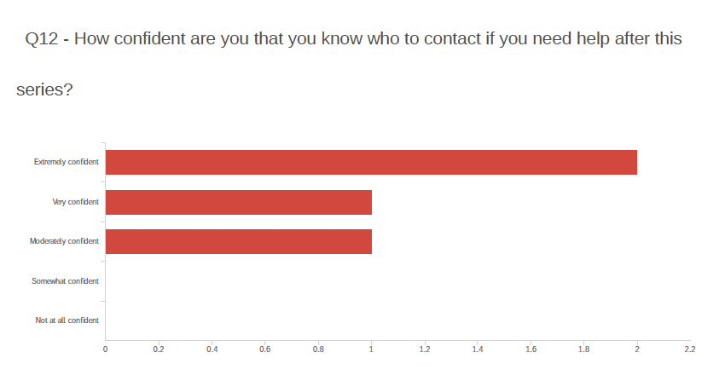
Feedback

Slide 22
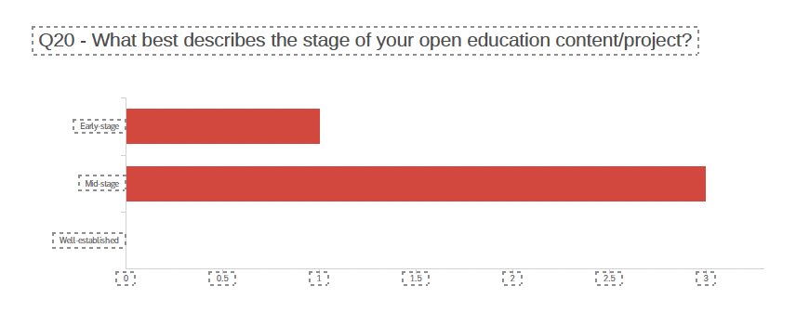
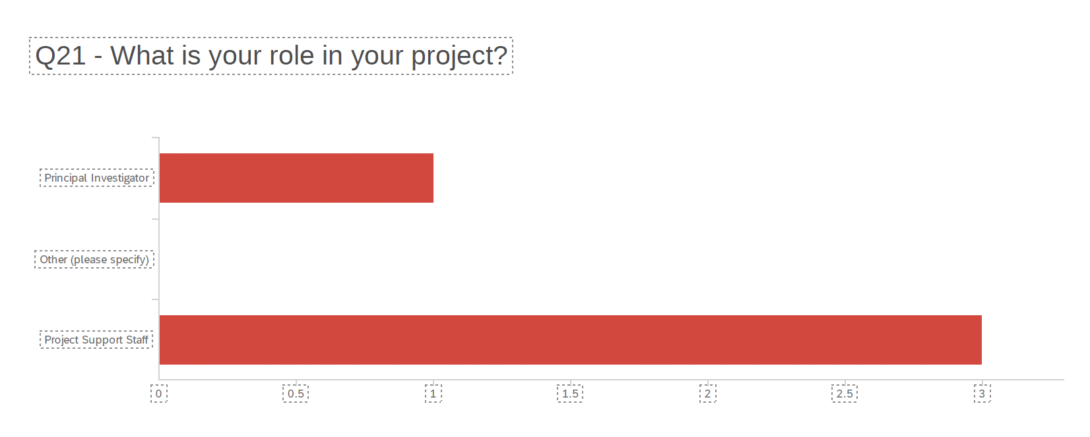
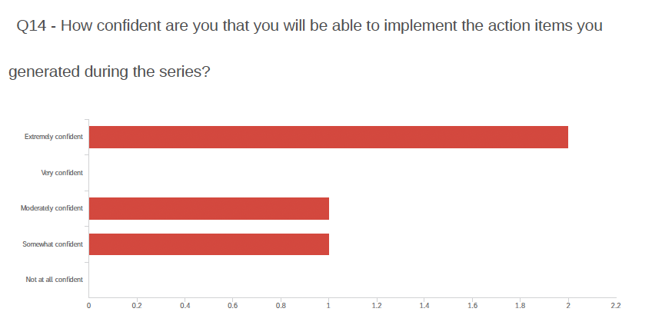
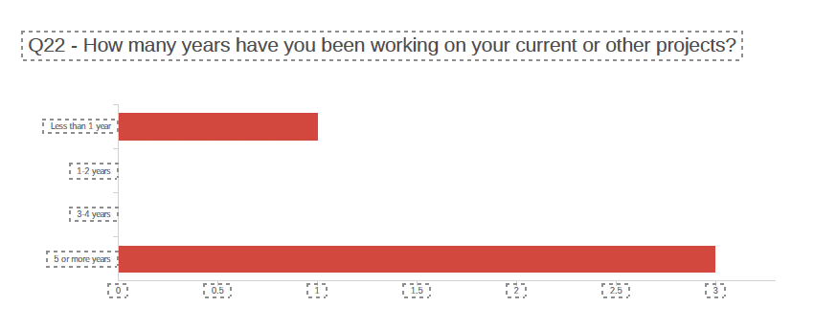
Feedback

Slide 23
Feedback
What would have improved the sustainability training for you?
“The only thing that could have improved my experience was if more members of my Platform team attended. I feel like there was real value in having technologists involved in the session as well as project managers.”
“One thing that would have been good to incorporate in the workshop is how to manage conﬂicts in the team around "sustainability" topics. Some people feel that commercialising our platform is not good and distributing the income from such a commercial entity causes friction in the team.”
“Some of the activities did not seem to translate to our use case. There was excessive mentioning of eBIRD as an exemplar. Not very many of our projects are of that scale or with that level of global appeal. It left me feeling like a lame duck.”

Slide 24
Feedback
“Our platform made a lot of valuable progress in these sessions and spent a lot of time outside of the sessions to work on the activities. We ended up with a better understanding of our platform. I feel like there should be more focused workshops like these for platforms in the future.”
“It was much more useful than I expected it to be. I think what our team has learnt will go a long way towards helping create a sustainable platform. Thanks very much!”
“Great initiative!”
“I think the afternoon sessions where teams were able to meet and work on the exercises were really valuable. We had a breakthrough in one session when we locked in our value propositions and another when we identified the two axes of our market landscape. We definitely needed the time in these sessions to have those discussions.”

Slide 25
Conclusion
SGCI and ARDC consider the Focus Week a success
Sustainability is part of the standard training for ARDC now
Are you interested to have something similar?

Slide 26
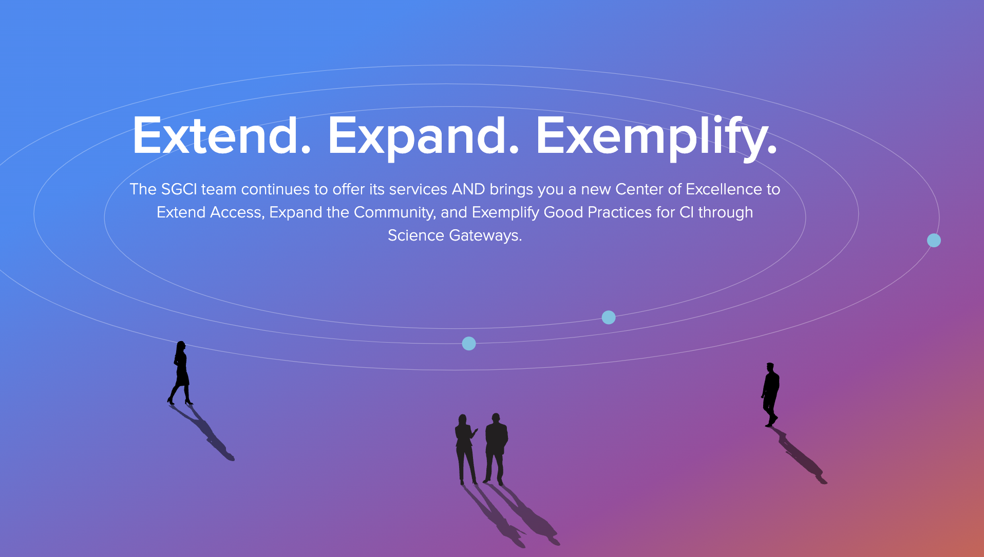
Thank You
Sandra Gesing
sgesing@uillinois.edu
https://sciencegateways.org/

