Slide 1
The Value of Research Science Gateways and Computing Cyberinfrastructure

Slide 2
What is a Science Gateway?

Slide 3
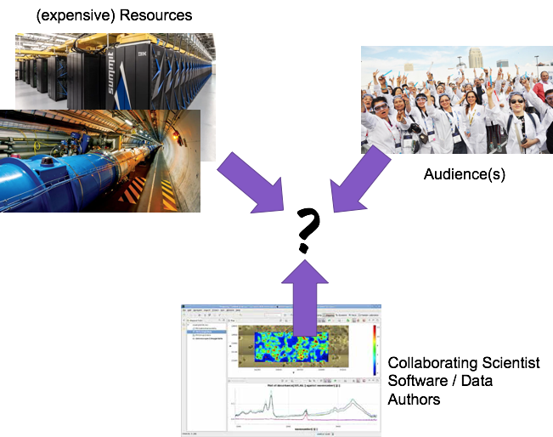
What is a Science Gateway?
Connecting expensive resources & data to
scientist authors that write codes to utilize them to
audiences that use those codes, data, instruments, collaborate, educate, etc. en masse

Slide 4
What is a Science Gateway?

Slide 5
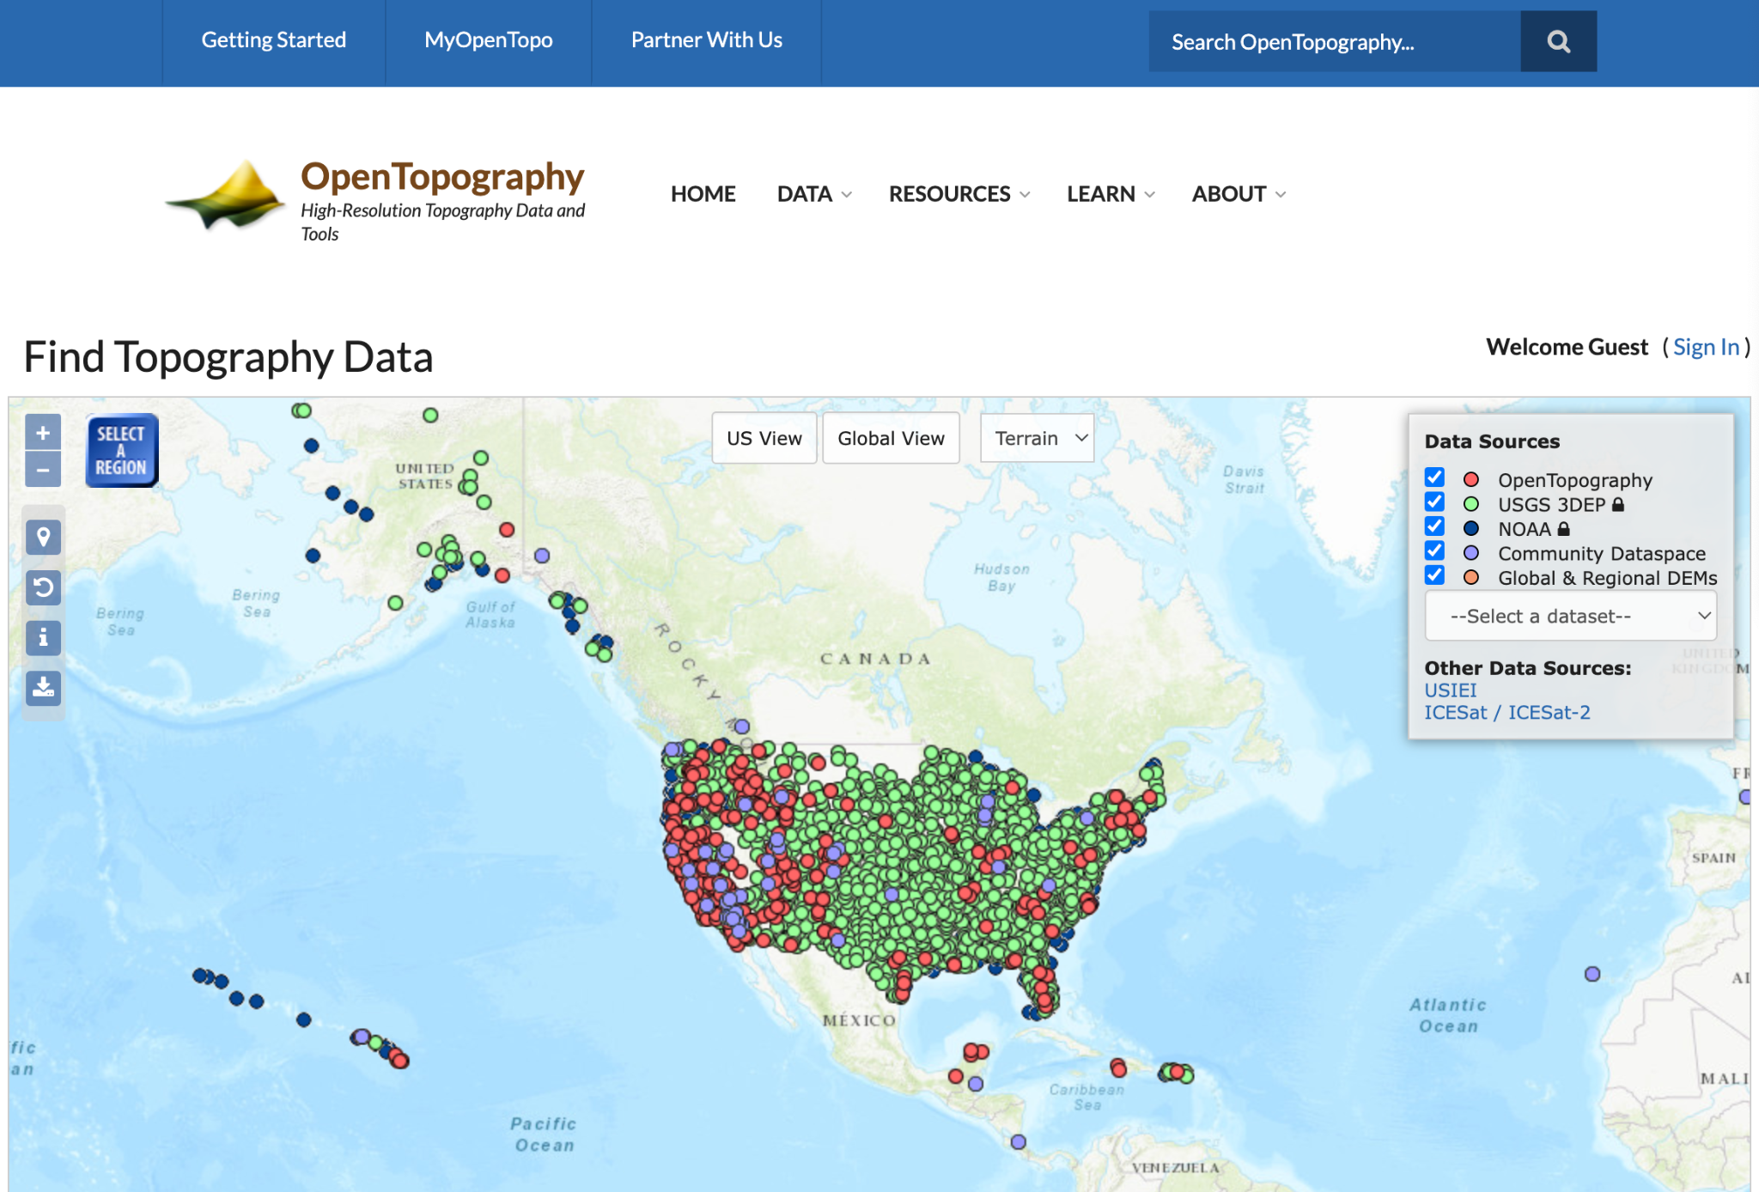
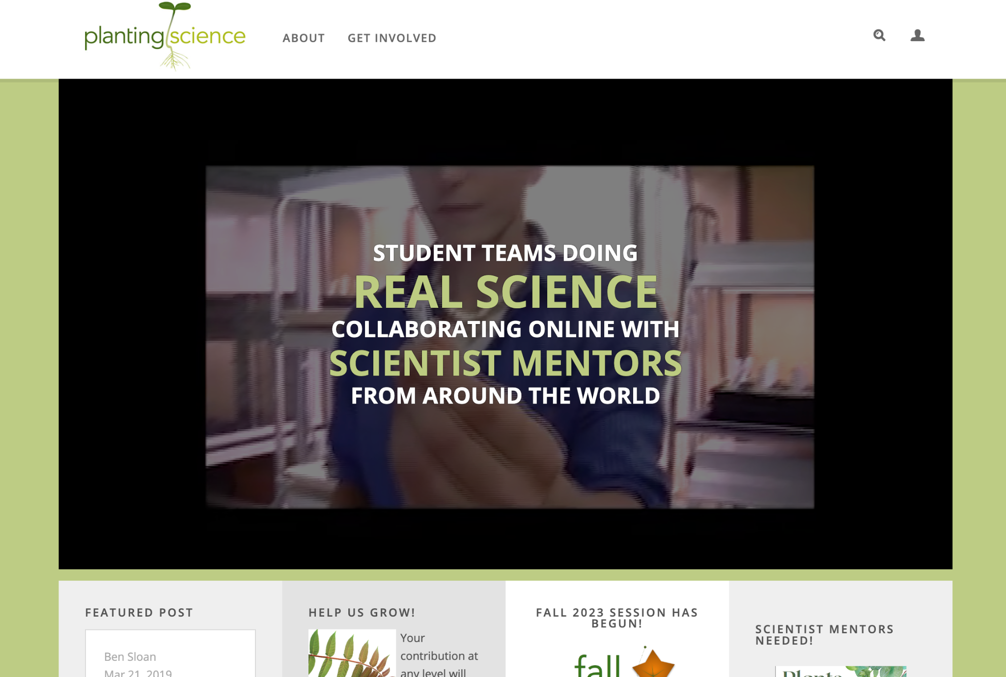
What does a Science Gateway do?
Connecting researchers and educators
providing access to research software
lower the barrier to educational materials and research

Slide 6
What is a Science Gateway?

Slide 7
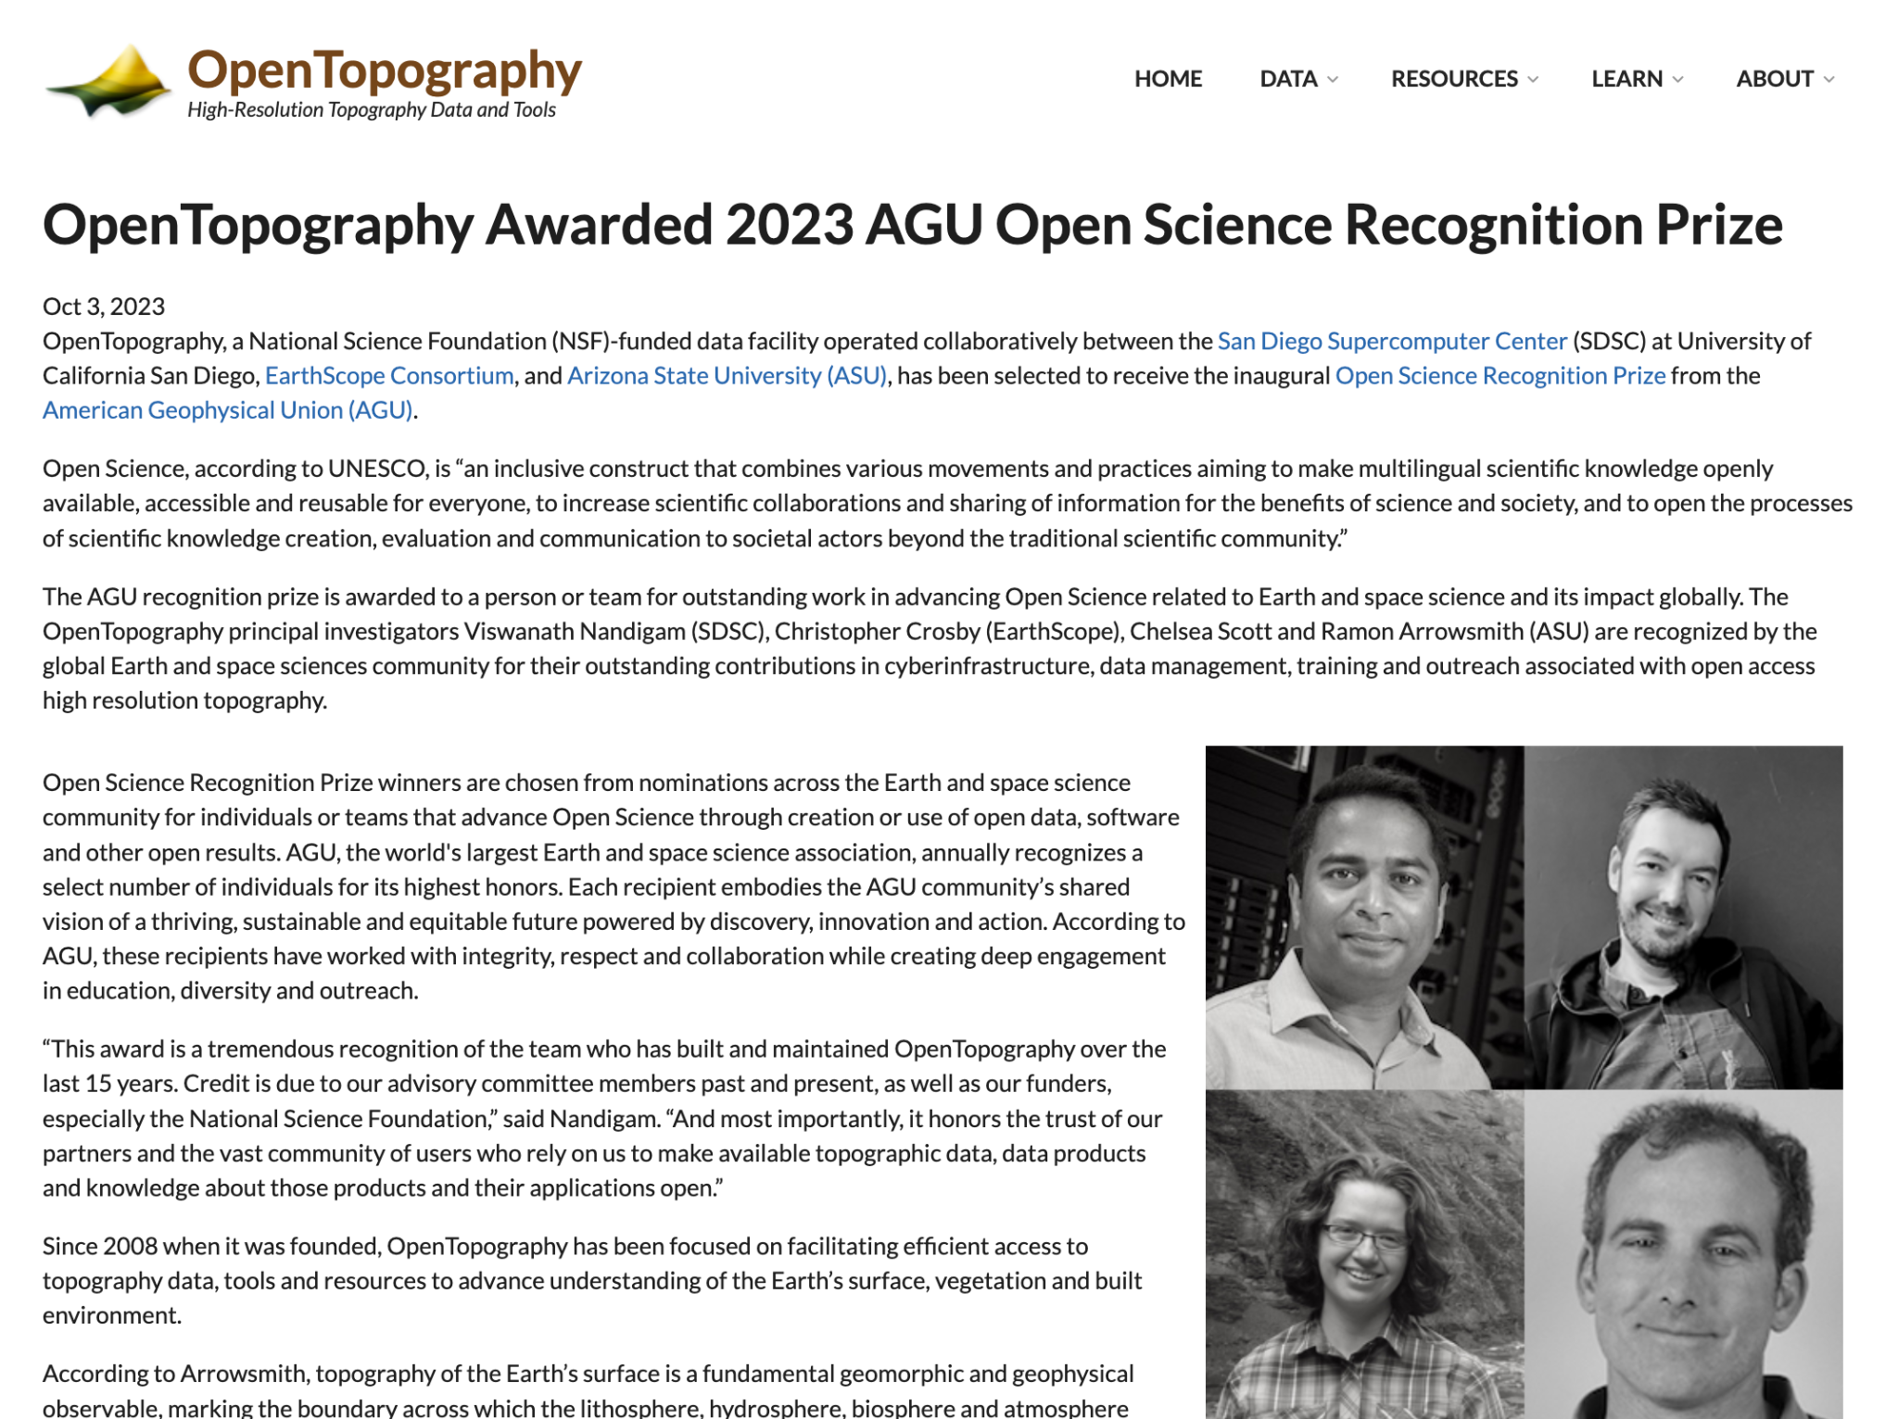
But what is the value?
Science Gateways democratize access to research and education -- lowering the barrier to ‘time to science’ and elevating impacts.
“This Open Science prize acknowledges the global impact of open data and an OpenTopography platform that makes these data easy to access and use regardless of computing resources and specialized skills”
Credit: https://opentopography.org/

Slide 8
Raise your hand if…
Your job involves any form of value communication

Slide 9
If you didn’t raise your hand yet
Raise your hand if…
you have ever submitted a proposal or sent a ‘convincing’ email

Slide 10
Recognize yourself as a value communicator
Communicating value is…
Important to your audience and solves a problem or addresses a need
Identifies your project’s unique value

Slide 11
Now that we have talked about the value of science gateways let’s hear from other value communicators

Slide 12
Panelists
Susan Tussy Globus Communications and Outreach Lead
Sandra Gesing SGX3 Community Engagement Lead
John Strawn Ohio Technology Consortium Communications Manager
Rob Quick Director of the Cyberinfrastructure Integration Research Center
Sean Cunningham Manager of Media Services

Slide 13
What are some of the unique considerations when conducting outreach in the academic and national lab space?

Slide 14
In what ways do you measure the success of your marketing efforts, and how do you gauge impact?

Slide 15
How do you leverage data analytics and user insights to refine your marketing strategies and better understand your audience's needs?

Slide 16
Can you share examples of successful campaigns or initiatives that have effectively increased the visibility of your projects?

Slide 17
What advice do you have for organizations looking to enhance their marketing and communication strategies?

Slide 19
Science Gateways Center of Excellence
Practical advice Networking & Thought Leadership Career development
Consulting
Sustainability training – Focus Week & Jumpstart
Technology selection consulting
Usability & graphic design consulting
Community
Annual Gateways Conference – Bozeman, MT – Oct. 2024
Blueprint Factories
Community surveys
Monthly webinars
Visiting presentations “On the road”
Workforce Development
Faculty & Student Hackathons
Summer Internship Experience @ TACC 2024

Slide 20
What SGCI + SGX3 DOES
Attendees at
Presentations
Active
subscribers
1,361
student & faculty participants
265
letters of collaboration
9,405
1,795
709
Focus Week
Attendees
6
4
Blueprint
Factories
Community Surveys
235
Science Gateways Supported
11
partners
18
Science Gateway Partners
Technical
Consulting
projects
$11,793,079
additional funding written into external projects
632
Gateway Catalog entries
54

Slide 21
Learn more at sciencegateways.org

Slide 22
Thank You!

Slide 23
With the growing importance of data analytics, artificial intelligence, and machine learning, how does your project(s) position themselves in relation to these fields? And do you have expertise to communicate to potential collaborators and users?

Slide 24
How do you use social media platforms to engage with your target audience and promote your services?

Slide 25
What methods do you use to reach out to potential partners or collaborators in the research and education communities to expand your outreach and impact?

